Slide 1









HOUSE OF GRACE FELLOWSHIP
Grounded in the Word · Renewed in Christ
Saved by Grace, Made New
EPHESIANS 2:8-9
2 CORINTHIANS 5:17
For by grace you have been saved through faith; and this is not of yourselves, it is the gift of God; not a result of works, so that no one may boast.
Therefore, if any man be in Christ, he is a new creature: old things are passed away; behold, all things are become new.

Slide 2


Can I Trust God When Life Falls Apart?
Primary Text: Matthew 4:1-11
Can I Trust God When Life Falls Apart?

Slide 3

POINT 1
📖 Trust His Word Over Immediate Wants
Can I Trust God When Life Falls Apart?

Slide 4
Matthew 3:16-17
6 And when Jesus was baptized, immediately He went up from the water, and behold, the heavens were opened to Him, and He saw the Spirit of God descending like a dove and coming to rest on Him; 17 and behold, a voice from heaven said, “This is my Beloved Son, with whom I am well pleased.
Can I Trust God When Life Falls Apart?

Slide 5
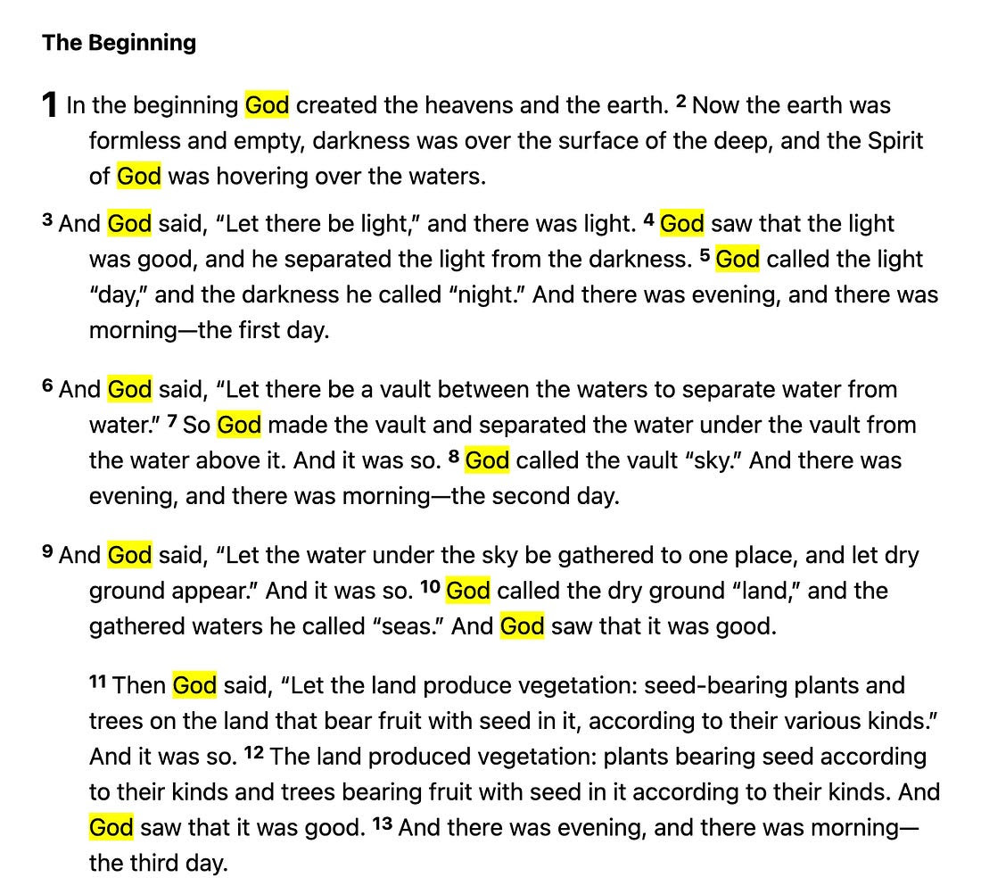
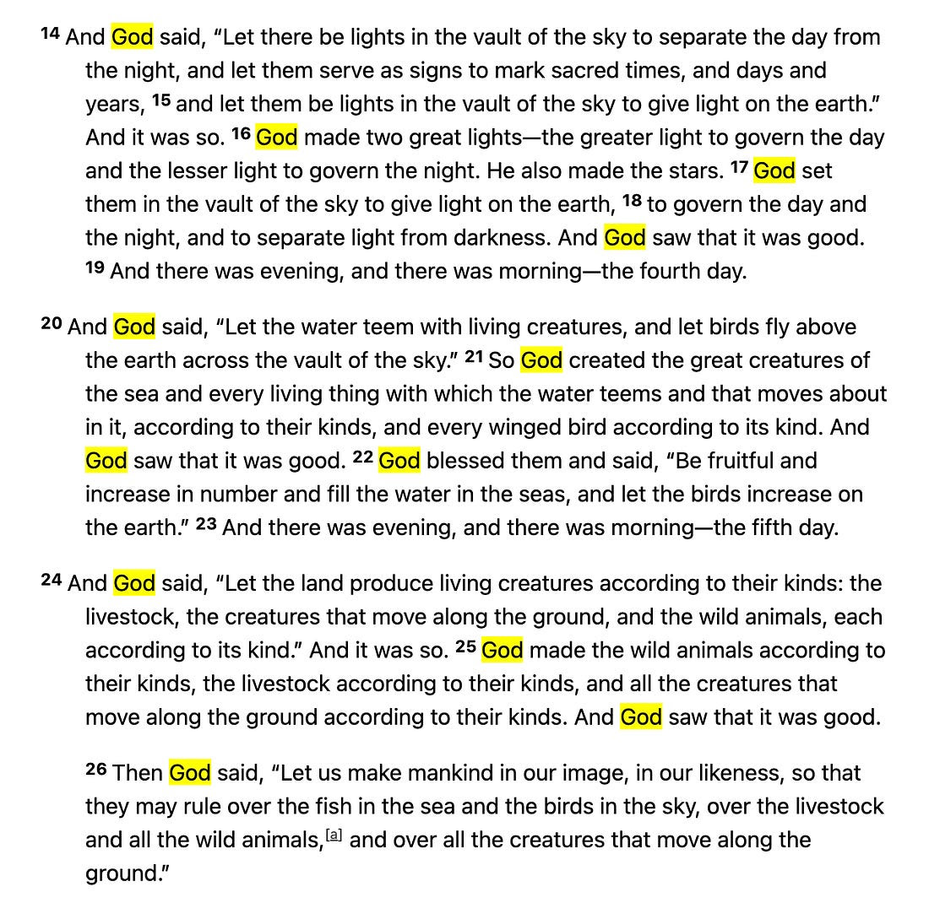
Can I Trust God When Life Falls Apart?

Slide 6
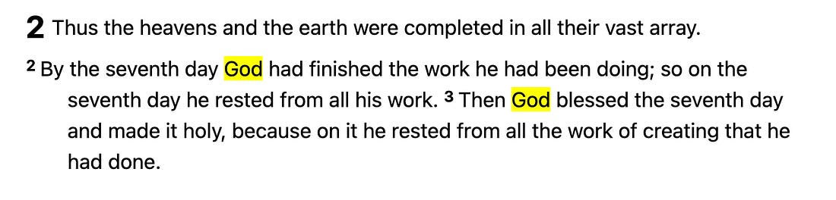
Can I Trust God When Life Falls Apart?

Slide 7
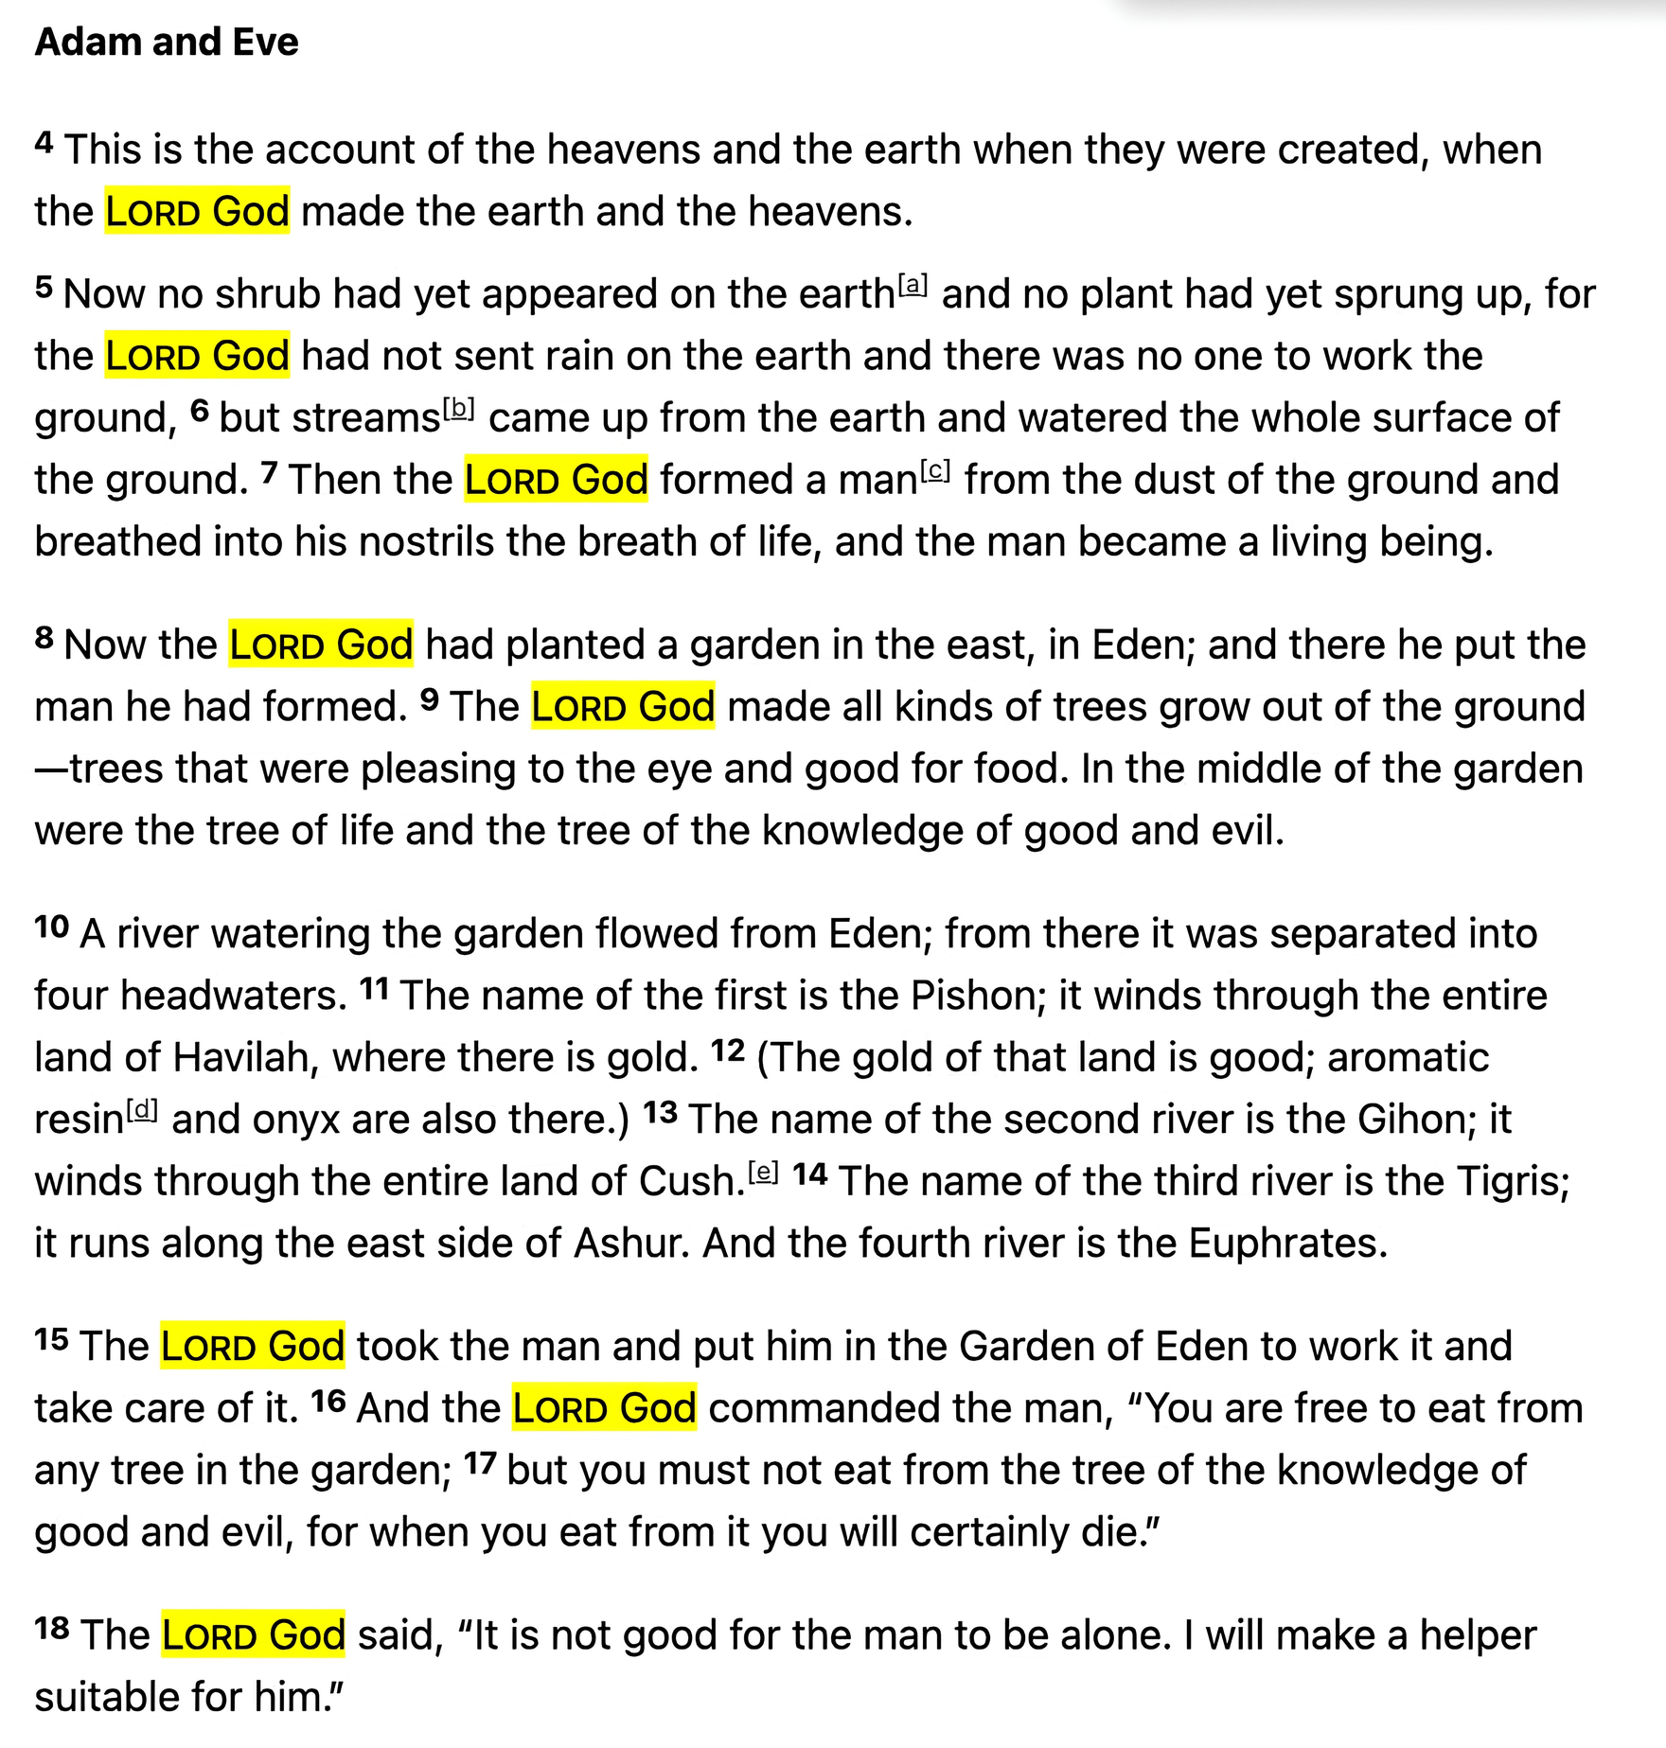
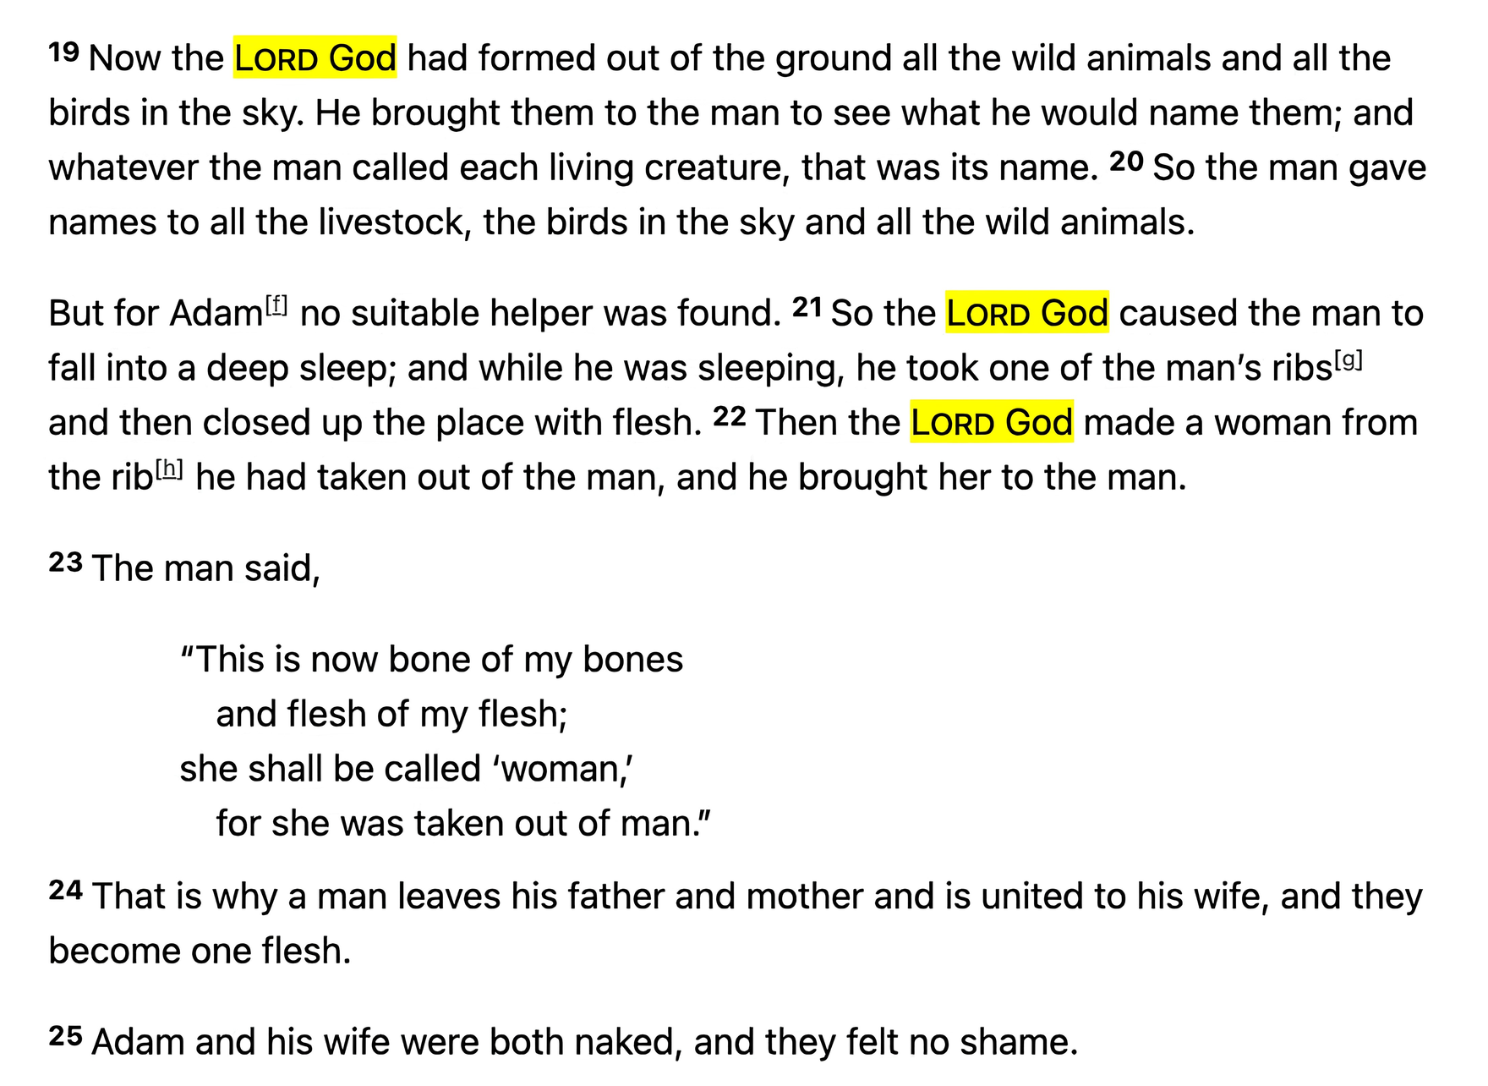
Can I Trust God When Life Falls Apart?

Slide 8
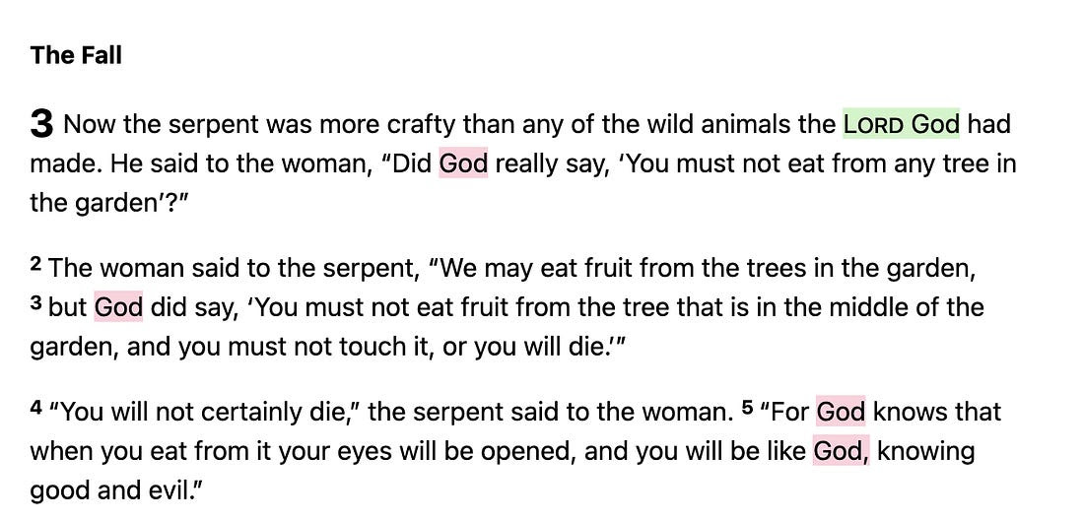
Can I Trust God When Life Falls Apart?

Slide 9


POINT 2
TRUST GOD WHEN YOU CAN'T SEE THE WAY FORWARD
Can I Trust God When Life Falls Apart?

Slide 10
POINT 2
Joshua 3:10–11
Here is how you shall know that the living God is among you... Behold, the ark of the covenant of the Lord of all the earth is passing over before you into the Jordan.
Can I Trust God When Life Falls Apart?

Slide 11
POINT 2
Joshua 3:13
And when the soles of the feet of the priests bearing the ark of the LORD, the Lord of all the earth, shall rest in the waters of the Jordan, the waters of the Jordan shall be cut off from flowing.
Can I Trust God When Life Falls Apart?

Slide 12
POINT 2
Joshua 3:15–16
And as soon as those bearing the ark had come as far as the Jordan, and the feet of the priests bearing the ark were dipped in the brink of the water... the waters coming down from above stood still.
Can I Trust God When Life Falls Apart?

Slide 13
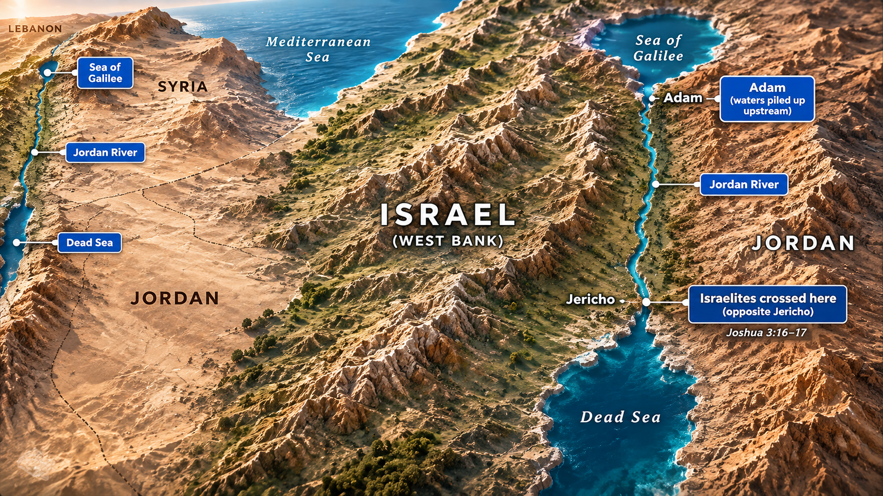
Can I Trust God When Life Falls Apart?

Slide 14

Joshua 3:17
And the priests bearing the ark of the covenant of the LORD stood firmly on dry ground in the midst of the Jordan, and all Israel was passing over on dry ground until all the nation finished passing over the Jordan.
Can I Trust God When Life Falls Apart?

Slide 15
Discussion Questions
  When life suddenly falls apart, what is usually your first reaction: fear, worry, taking control, or trusting God? Why?
  Jesus trusted God’s Word even when He was hungry and being tempted. What can we learn from His response when we face difficult situations?
  What is one practical way you can “trust His Word, trust His character, trust His timing, and take the next step of faith” this week?
Can I Trust God When Life Falls Apart?

