Slide 1






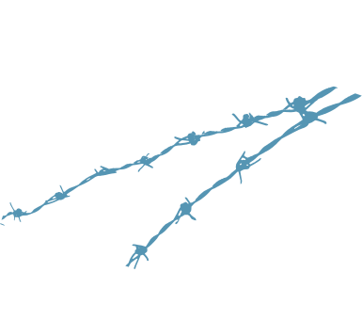













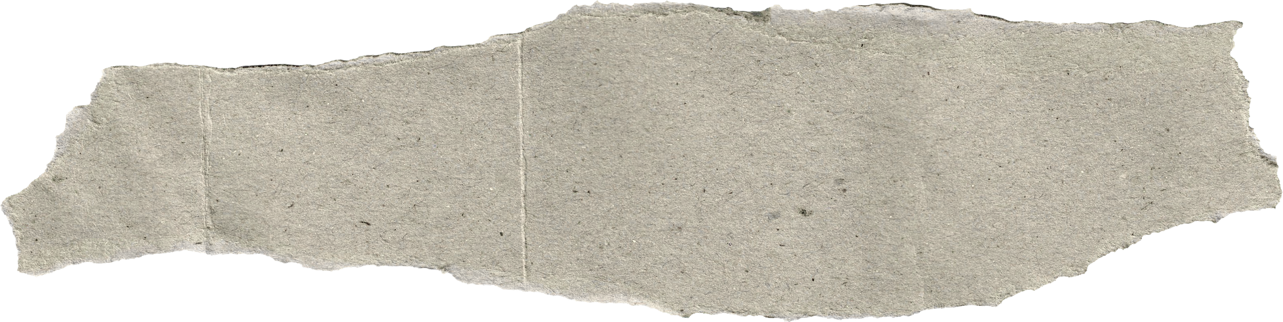



HOUSE OF GRACE FELLOWSHIP
Grounded in the Word · Renewed in Christ
Saved by Grace, Made New
EPHESIANS 2:8-9
2 CORINTHIANS 5:17
For by grace you have been saved through faith; and [l]this is not of yourselves, it is the gift of God; not a result of works, so that no one may boast.
Therefore, if any man be in Christ, he is a new creature: old things are passed away; behold, all things are become new.

Slide 2
THE BIBLICAL DECISION PROCESS:
WISDOM FROM GRACE, NOT FEAR
The Biblical Decision Process: Wisdom from Grace, Not Fear

Slide 3
  Decide From Your Identity, Not Your Anxiety
WISDOM begins at the CROSS, NOT AT THE CROSSROADS.
The Biblical Decision Process: Wisdom from Grace, Not Fear

Slide 4
2 Timothy 1:7
For God has not given us a sPIRIT OF FEAR, BUT OF POWER, OF LOVE, AND OF A SOUND MIND.
The Biblical Decision Process: Wisdom from Grace, Not Fear

Slide 5
Romans 8:15
You did not receive a sPIRIT OF SLAVERY TO FALL BACK INTO FEAR, BUT THE SPIRIT OF ADOPTION, BY WHOM WE CRY, ‘ABBA, FATHER.
The Biblical Decision Process: Wisdom from Grace, Not Fear

Slide 6
Most bad decisions are not information problems; they’re IDENTITY PROBLEMS. WE DECIDE BADLY BECAUSE WE’RE TRYING TO EARN SOMETHING CHRIST ALREADY GAVE US FREE.
The Biblical Decision Process: Wisdom from Grace, Not Fear

Slide 7
On the cross, Jesus said, “It is fINISHED.” YOUR ACCEPTANCE IS FINISHED. SO, YOU DECIDE FROM ACCEPTANCE, NOT FOR IT.
The Biblical Decision Process: Wisdom from Grace, Not Fear

Slide 8
2. Seek God’s Wisdom ThROUGH HIS WORD AND HIS SPIRIT.
The Biblical Decision Process: Wisdom from Grace, Not Fear

Slide 9
James 3:7
But the wisdom from above is first PURE, THEN PEACE-LOVING, GENTLE, REASONABLE, FULL OF MERCY AND GOOD FRUITS, IMPARTIAL, FREE OF HYPOCRISY
The Biblical Decision Process: Wisdom from Grace, Not Fear

Slide 10
JAMES 3:7
  Pure: Wisdom isn’t mixed with spiritual compromise or guilt-driven motives; it’s clean at the root.
  Then peaceable… gentle… reasonable: True wisdom doesn’t create chaos, arguments, or spiritual intimidation. It brings steadiness and kindness.
  Full of mercy… good fruits: God’s wisdom acts with compassion and produces visible fruit, especially toward others, not self-promotion.
  Impartial… without hypocrisy: It’s consistent. No double-life, no “religious talk” hiding the heart.
The Biblical Decision Process: Wisdom from Grace, Not Fear

Slide 11
Colossians 2:3
In WHOM ARE HIDDEN ALL THE TREASURES OF WISDOM AND KNOWLEDGE.
The Biblical Decision Process: Wisdom from Grace, Not Fear

Slide 12
1 Corinthians 1:30
But it is due to Him that you are in Christ Jesus, who became TO US WISDOM FROM GOD, AND RIGHTEOUSNESS AND SANCTIFICATION, AND REDEMPTION
The Biblical Decision Process: Wisdom from Grace, Not Fear

Slide 13
Psalm 119:105
Your word is a lamP TO MY FEET AND A LIGHT TO MY PATH.
The Biblical Decision Process: Wisdom from Grace, Not Fear

Slide 14
  Walk Forward in Faith and REST IN HIS GRACE
YOU MAKE YOUR PLANS; GOD DIRECTS YOUR STEPS, SO YOU CAN BREATHE.
The Biblical Decision Process: Wisdom from Grace, Not Fear

Slide 15
Proverbs 16:9
The mind OF A PERSON PLANS HIS WAY,
BUT THE LORD DIRECTS HIS STEPS.
The Biblical Decision Process: Wisdom from Grace, Not Fear

Slide 16
Philippians 4:6-7
Do not be anxious about anything, but in EVERYTHING BY PRAYER AND SUPPLICATION WITH THANKSGIVING LET YOUR REQUESTS BE MADE KNOWN TO GOD. AND THE PEACE OF GOD, WHICH SURPASSES ALL UNDERSTANDING, WILL GUARD YOUR HEARTS AND YOUR MINDS IN CHRIST JESUS.
The Biblical Decision Process: Wisdom from Grace, Not Fear

Slide 17
Colossians 3:15
AND LET THE PEACE THAT COMES FROM CHRIST RULE IN YOUR HEARTS, FOR AS MEMBERS OF ONE BODY YOU ARE CALLED TO LIVE IN PEACE. AND ALWAYS BE THANKFUL.
The Biblical Decision Process: Wisdom from Grace, Not Fear

Slide 18
Romans 8:38-39
AND I AM CONVINCED THAT NOTHING CAN EVER SEPARATE US FROM GOD’S LOVE. NEITHER DEATH NOR LIFE, NEITHER ANGELS NOR DEMONS, NEITHER OUR FEARS FOR TODAY NOR OUR WORRIES ABOUT TOMORROW, NOT EVEN THE POWERS OF HELL CAN SEPARATE US FROM GOD’S LOVE. NO POWER IN THE SKY ABOVE OR IN THE EARTH BELOW, INDEED, NOTHING IN ALL CREATION WILL EVER BE ABLE TO SEPARATE US FROM THE LOVE OF GOD THAT IS REVEALED IN CHRIST JESUS OUR LORD.
The Biblical Decision Process: Wisdom from Grace, Not Fear

Slide 19
Colossians 3:15
AND LET THE PEACE THAT COMES FROM CHRIST RULE IN YOUR HEARTS, FOR AS MEMBERS OF ONE BODY YOU ARE CALLED TO LIVE IN PEACE. AND ALWAYS BE THANKFUL.
The Biblical Decision Process: Wisdom from Grace, Not Fear

Slide 20
Isaiah 30:21
YOUR OWN EARS WILL HEAR HIM.
RIGHT BEHIND YOU, A VOICE WILL SAY,
“THIS IS THE WAY YOU SHOULD GO,”
WHETHER TO THE RIGHT OR TO THE LEFT.
TRUST HIM. WALK CONFIDENTLY. DECIDE IN GRACE, NOT FEAR.
The Biblical Decision Process: Wisdom from Grace, Not Fear

Slide 21
ConCLUSION:
WALK CONFIDENTLY!
HIS SPIRIT LIVES IN YOU TO GUIDE YOU. HIS PROVIDENCE IS STRONG ENOUGH TO REDEEM EVEN YOUR MISSTEPS.
The Biblical Decision Process: Wisdom from Grace, Not Fear

