Slide 1



Slide 2


Slide 3
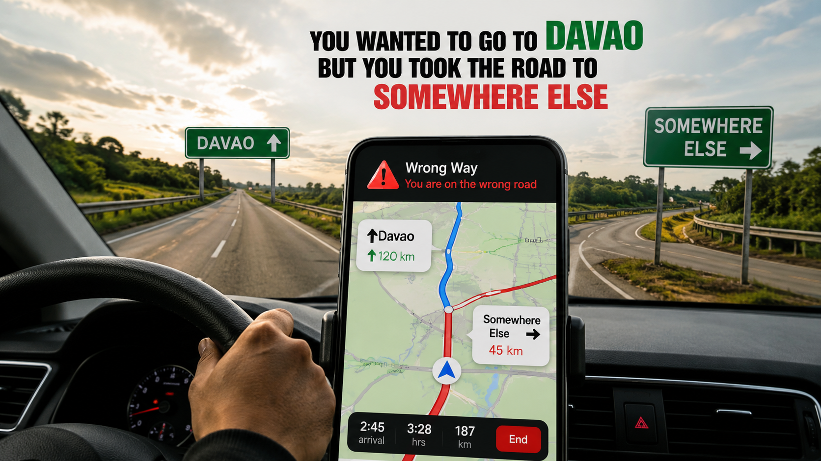

Slide 4


Slide 5


Slide 6
Hebrews 9:27
“People are destined to die once,
and after that to face judgment.”

Slide 7
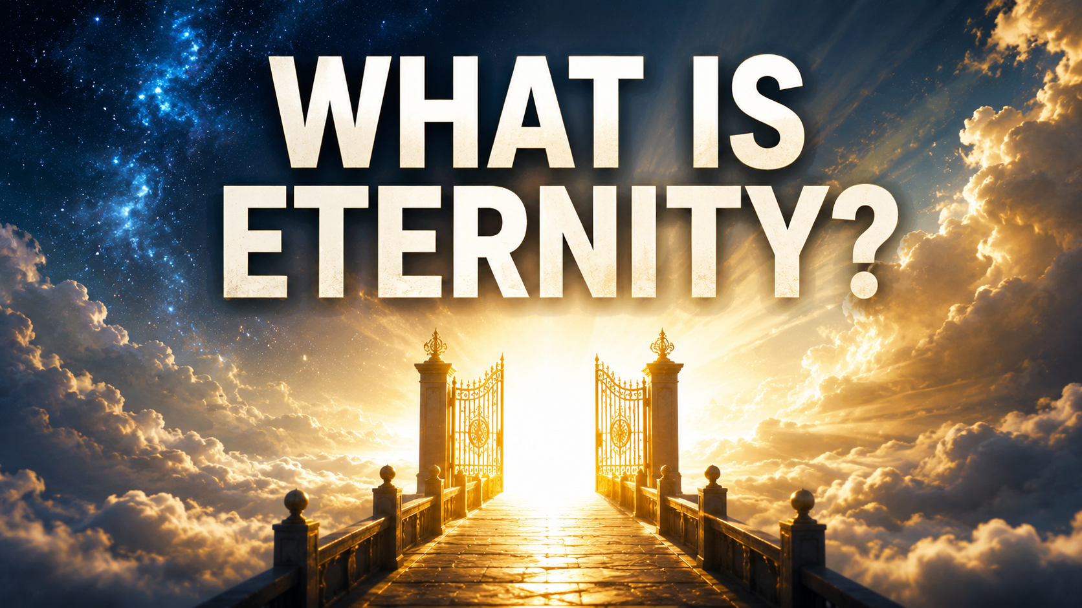

Slide 8
WHERE WILL YOU SPEND ETERNITY?

Slide 9


Slide 10
Matthew 7:13–14:
“Wide is the gate and broad is the road
that leads to destruction...
But small is the gate and narrow the road
that leads to life.”

Slide 12
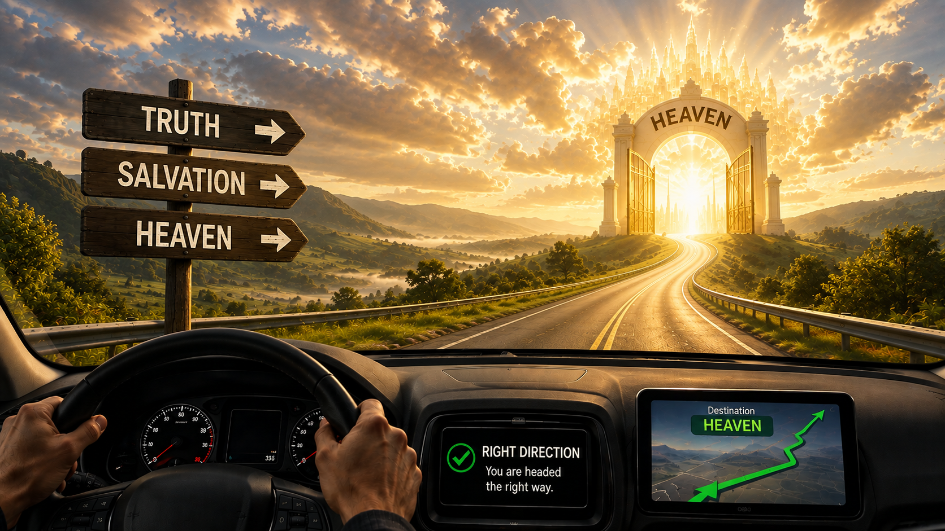

Slide 13
ROMANS 3:23
FOr ALL have sinned and fall short of the glory of God

Slide 14
Romans 6:23
....but the gift of God is eternal life
in Christ Jesus our Lord.

Slide 15
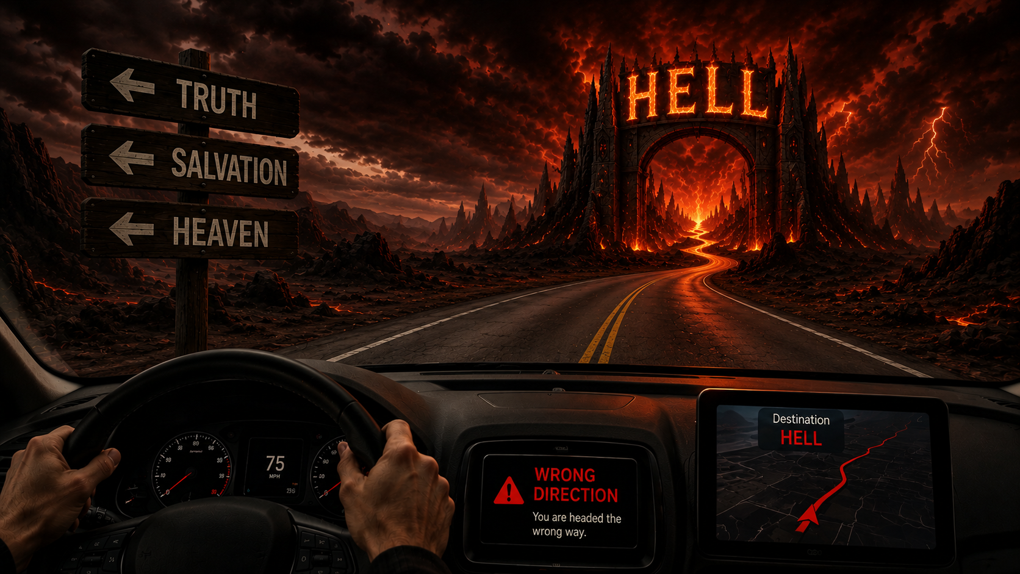

Slide 16
Isaiah 59:2
But your iniquities have separated you from your God

Slide 17
Romans 6:23
“For the wages of sin is DEATH...”

Slide 18
Matthew 25:46
Then they will go away to eternal punishment,
but the righteous to eternal life.

Slide 19
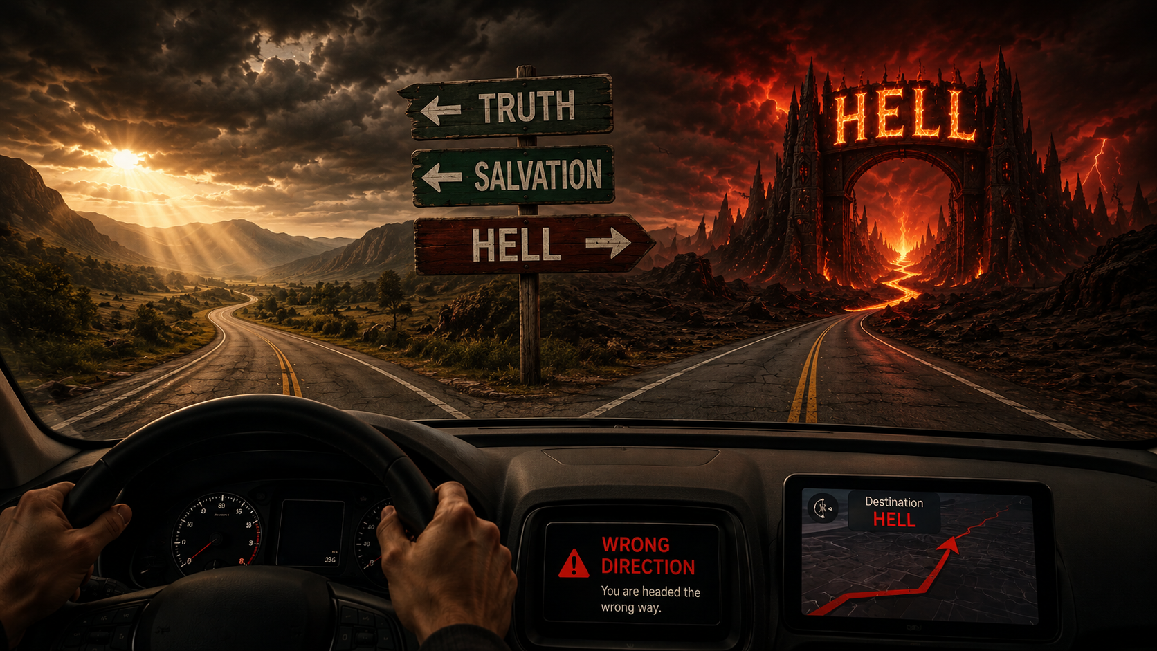

Slide 20


Slide 21
Ephesians 2:8–9
“For it is by GRACE you have been saved,
through FAITH—and this is not from yourselves,
it is the gift of God—not by works…”

Slide 22
Isaiah 64:6
We are all infected and impure with sin.
When we display our righteous deeds,
they are nothing but filthy rags.

Slide 23
When you realize you're on the wrong road,
The answer is to change destination.
And that change begins when you turn to Jesus.

Slide 24


Slide 25
John 3:16
For God so loved the world that he gave His one
and only Son, that whoever believes in him
shall not perish but have eternal life.

Slide 26
Ephesians 2:4-5
But God, being rich in mercy,
because of His great love with which He loved us, even when we were dead in our transgressions, made us alive together with Christ
(by grace you have been saved)

Slide 27
Romans 5:8
“But God demonstrates his own love for us in this: While we were still sinners, Christ died for us.”

Slide 28
John 14:6:
“I am the way and the truth and the life.
No one comes to the Father except through me.”

Slide 29
Hell does not have to be your destination.
Because Jesus made a way.
Jesus became the Way.

Slide 30
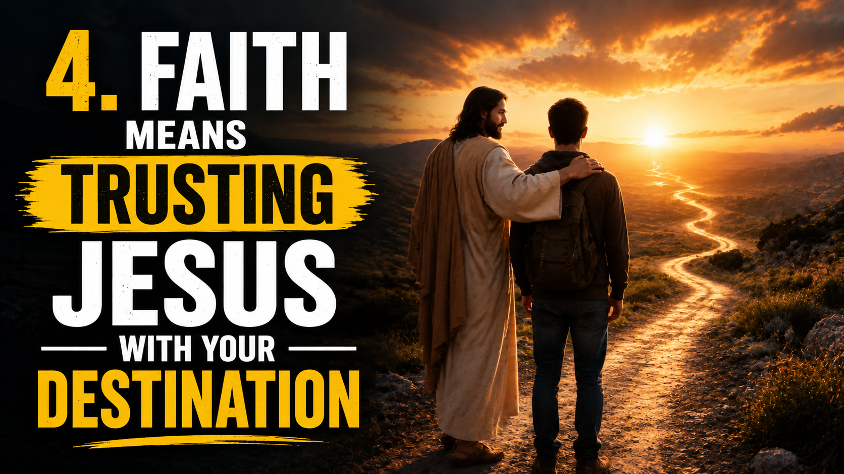

Slide 31
Ephesians 2:8–9 says:
“For it is by GRACE you have been saved,
through FAITH—and this is not from yourselves,
it is the gift of God—not by works…”

Slide 32
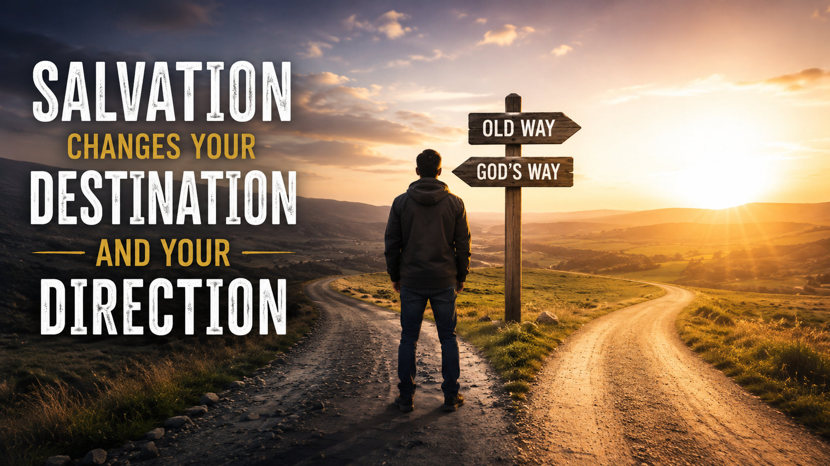
5

Slide 33
Salvation changes where you're going
and because of that,
it changes how you live today.

Slide 36
