Slide 1


Slide 2


Slide 3


Slide 4


Slide 5
Esther 1:1-2
This is what happened during the time of Xerxes,
the Xerxes who ruled over 127 provinces
stretching from India to Cush.
At that time King Xerxes reigned from his royal throne
in the citadel of Susa

Slide 6
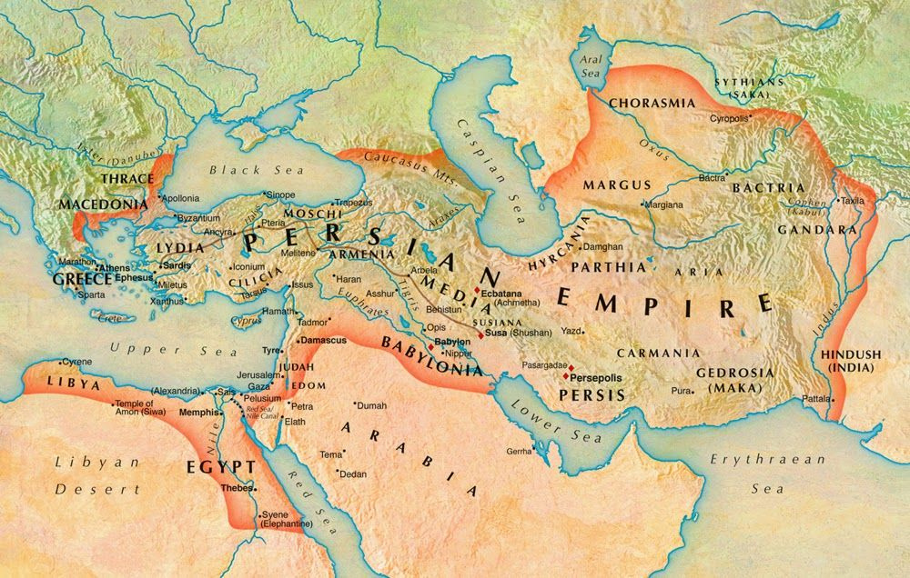

Slide 7
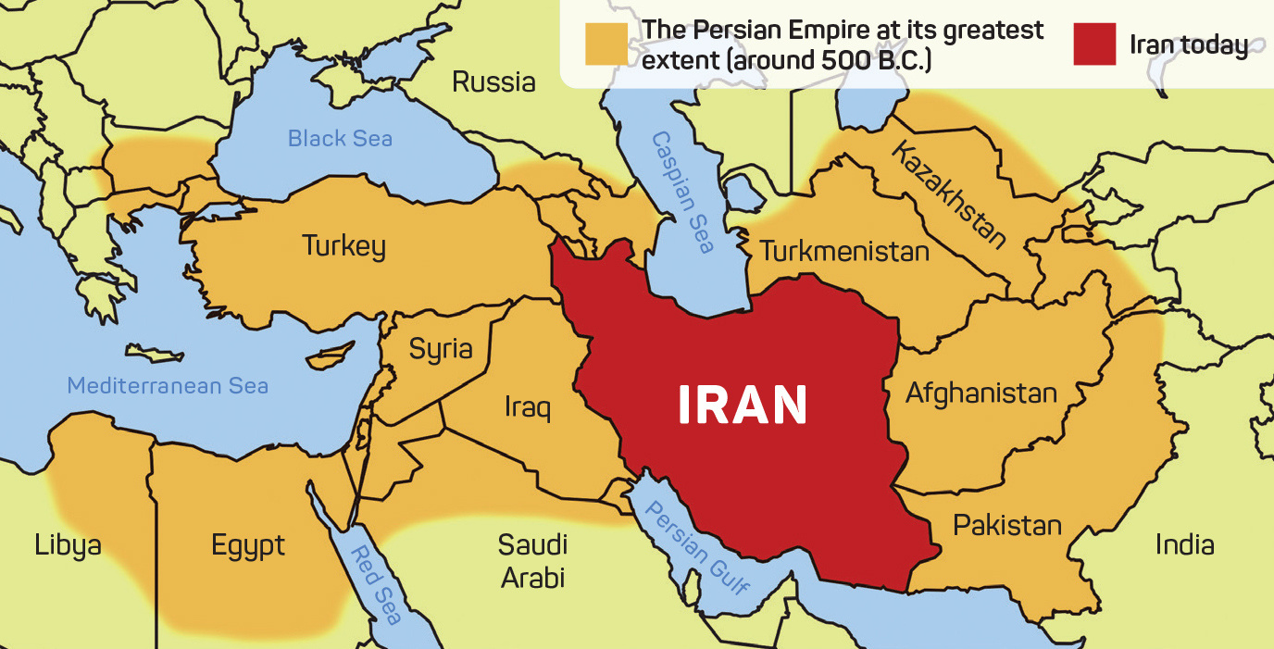

Slide 8
ESTHER 1:3–4
And in the third year of his reign he gave a BANQUET for all his nobles and officials. The military leaders of Persia and Media, the princes, and the nobles of the provinces were present.

Slide 9
ESTHER 1:4
For a full 180 days he displayed the vast wealth of his kingdom and the splendor and glory of his majesty.

Slide 10
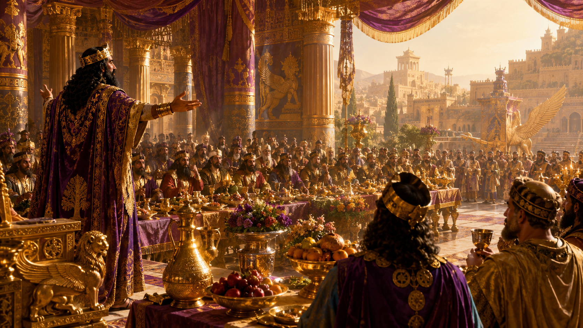

Slide 11
Esther 1:10
On the seventh day, when King Xerxes was in high spirits
from wine, he commanded the eunuchs
to bring before him Queen Vashti,
wearing her royal crown, in order to display her beauty
to the people and nobles, for she was lovely to look at.

Slide 12
Esther 1:12
But when the attendants delivered the king’s command,
Queen Vashti refused to come.
Then the king became furious and burned with anger.

Slide 14
Esther 2:2 -3
Let a search be made for beautiful young virgins for the king. Let the king appoint commissioners in every province of his realm to bring all these beautiful young women into the harem at the citadel of Susa.

Slide 15
Esther 2: 3-4
Let them be placed under the care of Hegai, the king’s eunuch, who is in charge of the women; and let beauty treatments be given to them. Then let the young woman who pleases the king be queen instead of Vashti.” This advice appealed to the king, and he followed it.

Slide 16
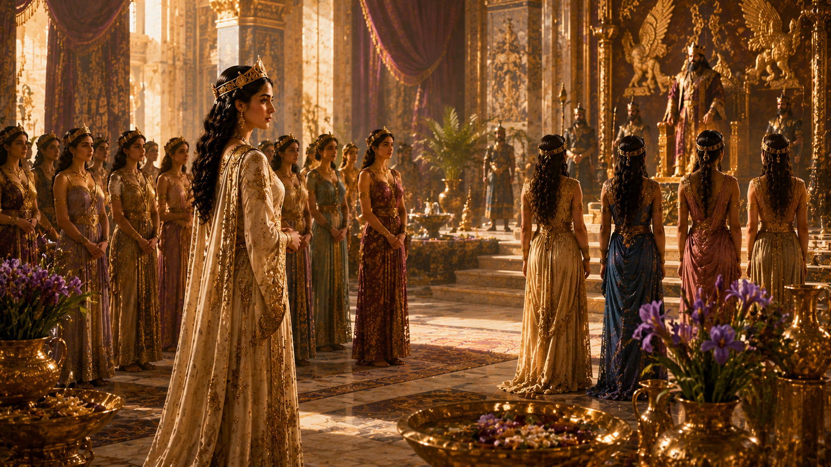

Slide 17
ESTHER 2:7
Mordecai had a cousin named Hadassah, whom he had brought up because she had neither father nor mother.
This young woman, who was also known as Esther,
had a lovely figure and was beautiful. Mordecai had taken her as his own daughter when her father and mother died.

Slide 18
ESTHER 2:17
“The king loved Esther more than all the women,
and she won grace and favor in his sight...
so that he set the royal crown on her head and made her Queen.”

Slide 19


Slide 20
GOD CAN POSITION YOU BEFORE
HE REVEALS THE PURPOSE OF YOUR POSITION.

Slide 21
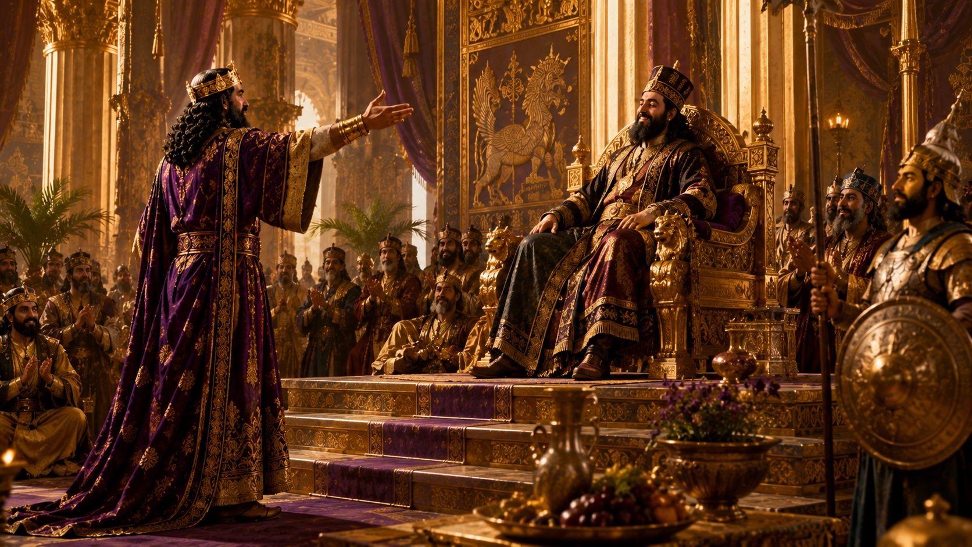

Slide 22
ESTHER 3:1
After these events, King Xerxes honored HAMAN son of Hammedatha, the Agagite, elevating him and giving him a seat of honor higher than that of all the other nobles.

Slide 23
ESTHER 3:2
All the royal officials at the king’s gate knelt down and paid honor to Haman, for the king had commanded this concerning him.
But MORDECAI would not kneel down or pay him honor.

Slide 24
ESTHER 3:13
“Letters were sent by couriers to all the king's provinces with instructions to destroy, to kill, and to annihilate all Jews,
young and old, women and children, in one day...”

Slide 25
ESTHER 4:1
“When Mordecai learned all that had been done,
Mordecai tore his clothes and put on sackcloth and ashes...”

Slide 26
ESTHER 4:11
“All the king’s officials and the people of the royal provinces know that for any man or woman who approaches the king in the inner court without being summoned the king has but one law:
that they be put to death unless the king extends the gold scepter
to them and spares their lives.
But thirty days have passed since I was called to go to the king.”

Slide 27
ESTHER 4:13–14
“Do not think that because you are in the king’s house you alone of all the Jews will escape. For if you remain silent at this time, relief and deliverance for the Jews will arise from another place,
but you and your father’s family will perish.

Slide 28
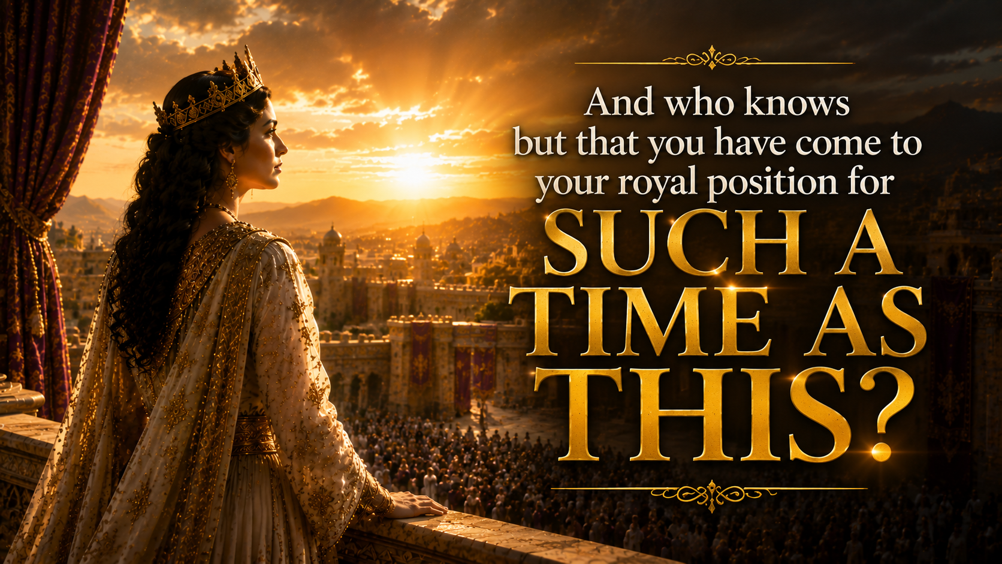

Slide 29


Slide 30
YOUR POSITION IS NOT JUST FOR YOUR BENEFIT

Slide 31
Your life is not just about what God can do FOR you.
It's about what God wants to do THROUGH you.

Slide 32
But purpose doesn't always call us to what's comfortable.
Sometimes purpose calls us to courage.

Slide 33


Slide 34
ESTHER 4:15–16
“Then Esther told them to reply to Mordecai,
‘Go, gather all the Jews... and fast for me...’”

Slide 35
ESTHER 4:16
“I will go to the king, though it is against the law,
and if I perish, I perish.”

Slide 36
Knowing your purpose isn't enough.
You have to respond to it.

Slide 37
ESTHER 5:1–2
On the third day Esther put on her royal robes and stood in the inner court of the palace, in front of the king’s hall.
The king was sitting on his royal throne in the hall,
facing the entrance.

Slide 38
ESTHER 5:1–2
When he saw Queen Esther standing in the court, he was pleased with her and held out to her the gold scepter that was in his hand.
So Esther approached and touched the tip of the scepter.

Slide 39
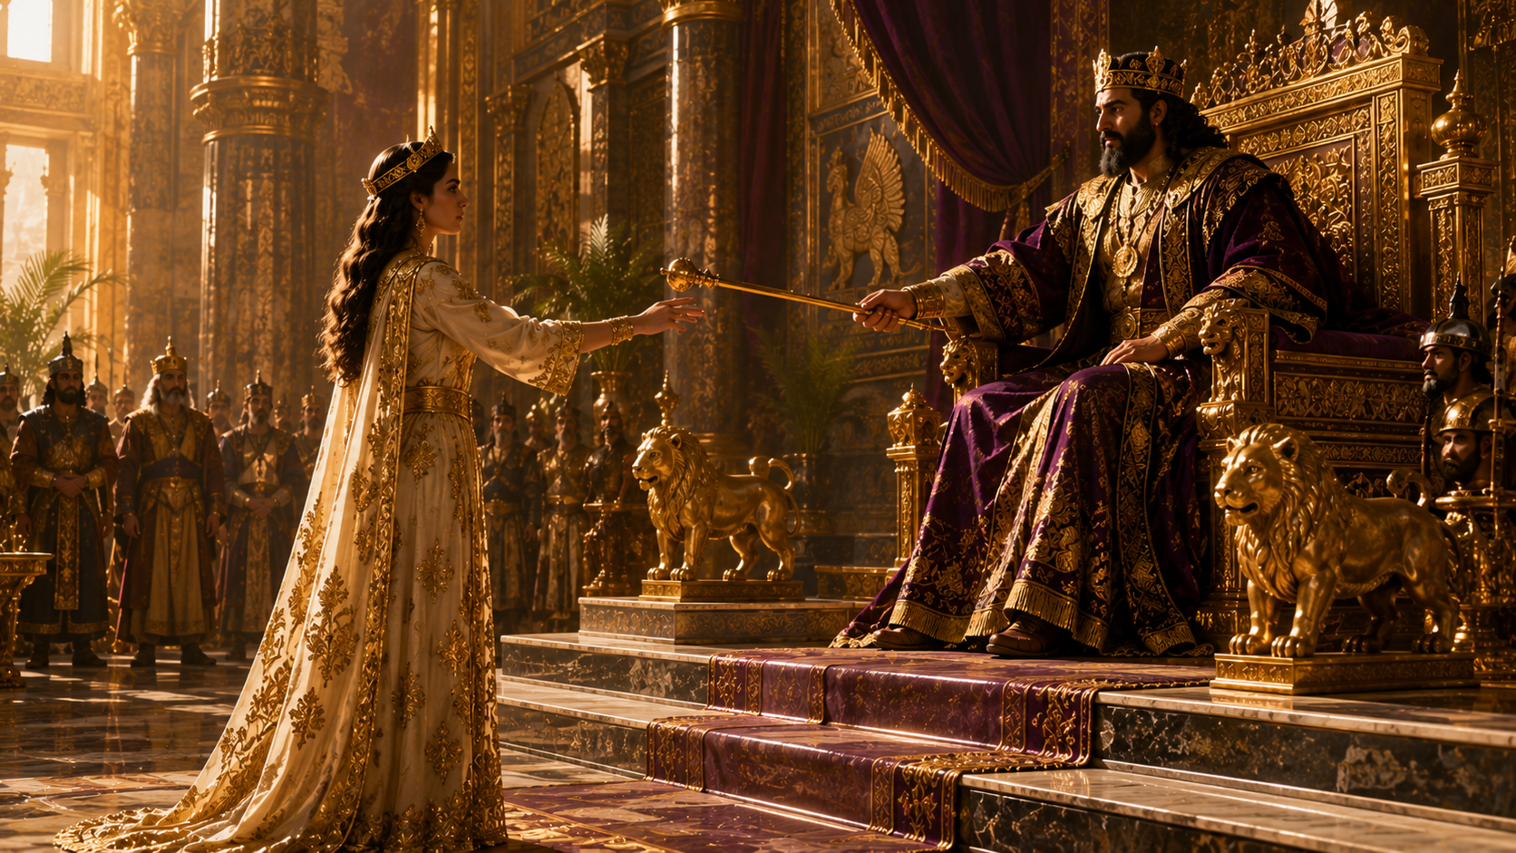

Slide 40
Isaiah 61:10
“He has clothed me with the garments of salvation;
he has covered me with the robe of righteousness.”

Slide 41
Hebrews 4:16
“Let us then with confidence
draw near to the throne of grace…”

Slide 43
Esther 5:3
Then the king asked, “What is it, Queen Esther?
What is your request?
Even up to half the kingdom, it will be given you.”

Slide 44
Esther 5:4
“If it pleases the king,” replied Esther,
“let the king, together with Haman,
come today to a banquet I have prepared for him.”

Slide 45
ESTHER 7:3
Then Queen Esther answered,
“If I have found favor with you, Your Majesty,
and if it pleases you, grant me my life—this is my petition.
And spare my people—this is my request.
For I and my people have been sold to be destroyed,
killed and annihilated.

Slide 46
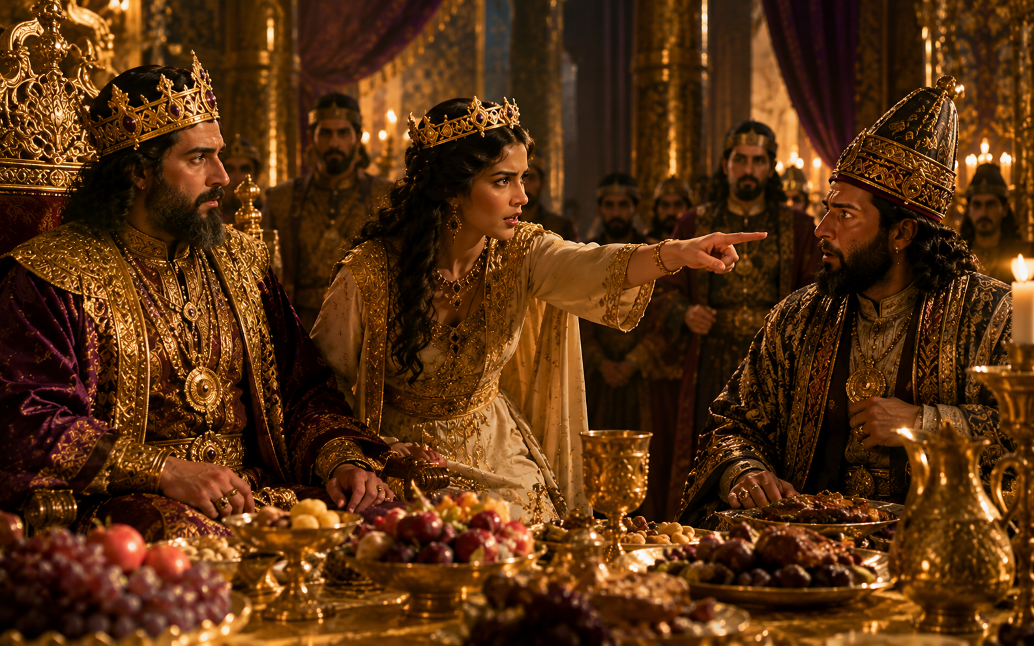

Slide 47


Slide 48
Esther 8:11
The king’s edict granted the Jews in every city the right to assemble and protect themselves; to destroy, kill and annihilate the armed men of any nationality or province who might attack them and their women and children, and to plunder the property of their enemies.

