Slide 1


Slide 2

What if the very thing you are trying to hide from God is the exact thing He wants to use the most?

Slide 3


Slide 4

"And He said to me, 'My grace is sufficient for you, for My power is made perfect in weakness.' Therefore most gladly I will rather boast in my infirmities, that the power of Christ may rest upon me... For when I am weak, then I am strong."
– 2 Corinthians 12:9-10

Slide 5
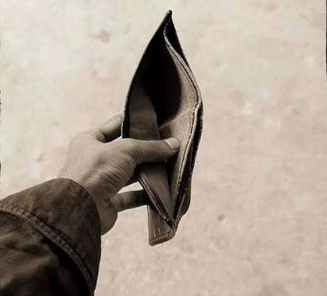
Empty is the perfect starting point.

Slide 6

When you are empty of self, you are full of Him!

Slide 7
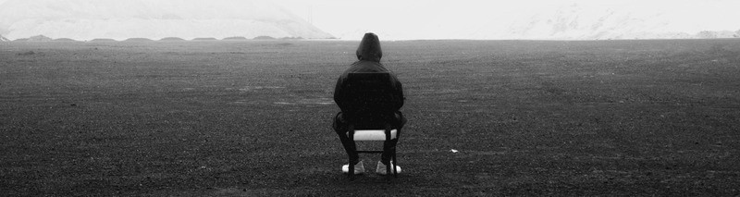
You don’t have to be flawlessly strong to be built to stand.

Slide 8
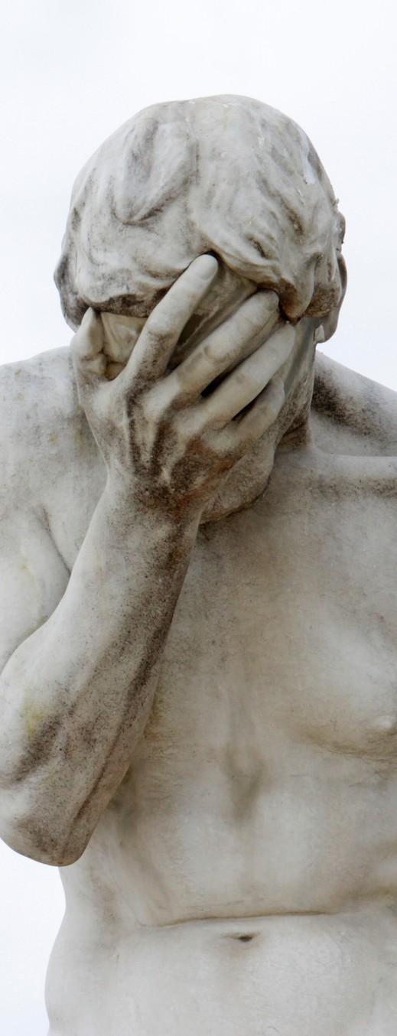
Never judge your standing by your state.

Slide 9
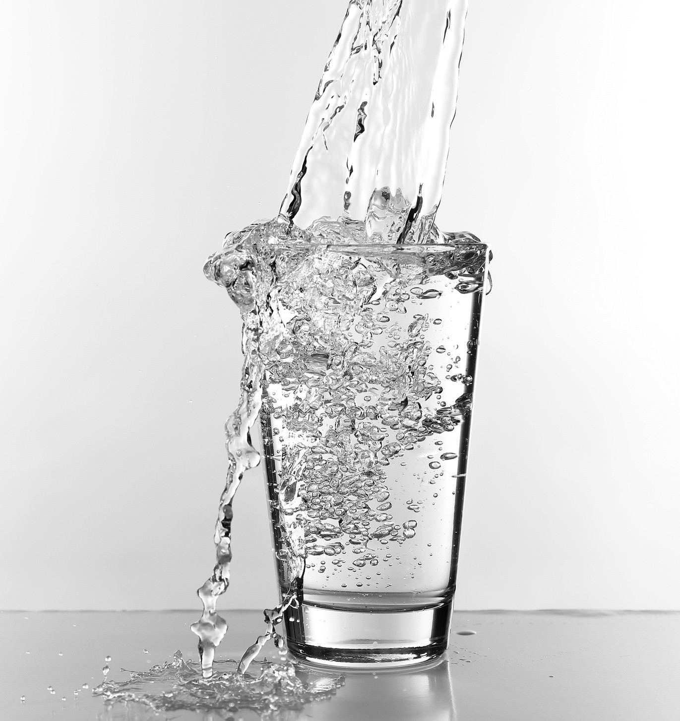
Moreover the law entered that the offense might abound.
But where sin abounded, grace abounded much more." – Romans 5:20

Slide 10
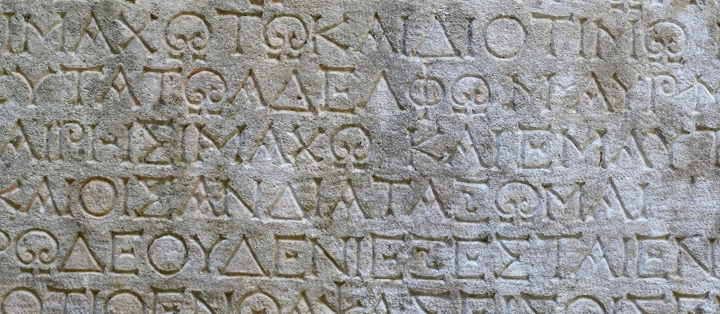
The ancient Greek verb pleonazō (πλεονάζω) means an
increase that you can measure or count.

Slide 11

huperperisseou - The Greek word perisseou (περισσεύω, perisseuō) means endless, immeasurable overflow, or have an abundance (more than enough) and, huper (ὑπέρ) primarily means "above," or "beyond".

Slide 12
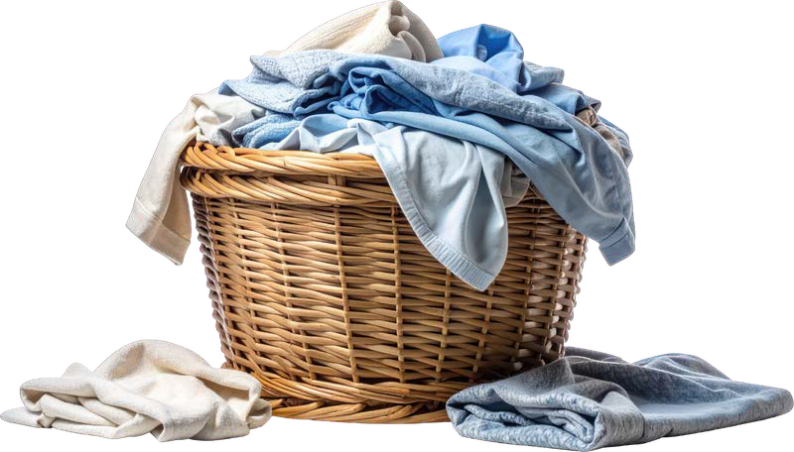
Where your weakness increases, God’s grace super-overflows.

Slide 13
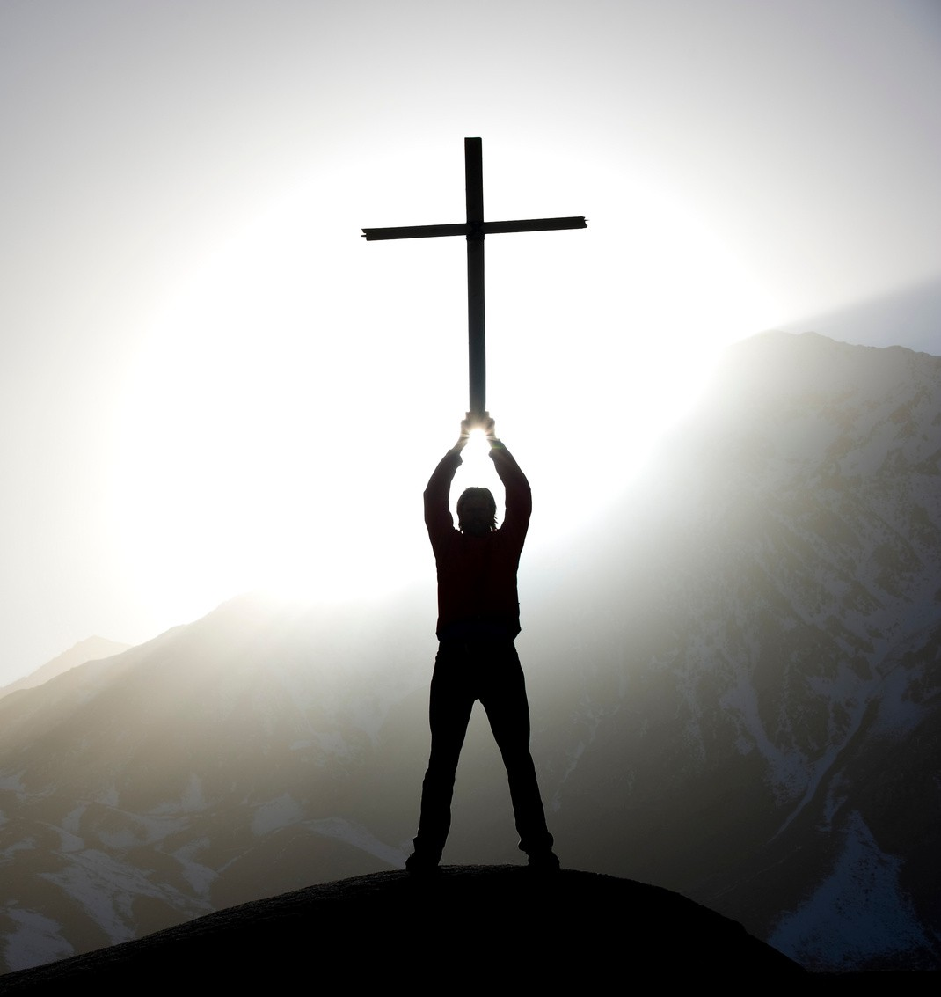
My grace is sufficient for you, for My strength is made perfect in weakness."
– 2 Corinthians 12:9

Slide 14
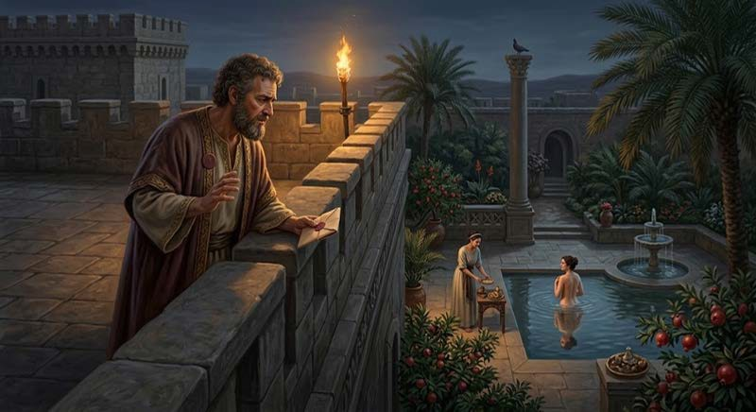

Slide 15
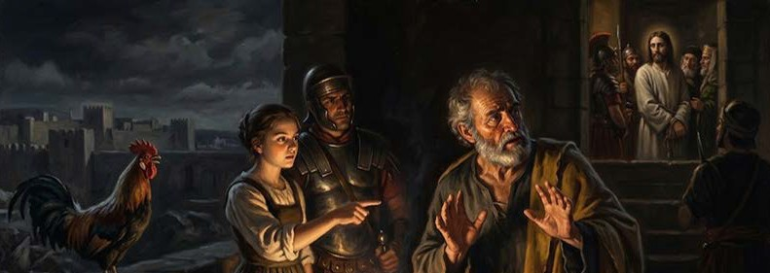

Slide 16


Slide 17

Your greatest weakness is the staging ground for God's superabounding grace.

Slide 18

Stop looking at your weakness as a minus, and start looking to the Master.

Slide 19

True deliverance isn't just forcing your behavior; it’s being overwhelmed by grace.

Slide 20
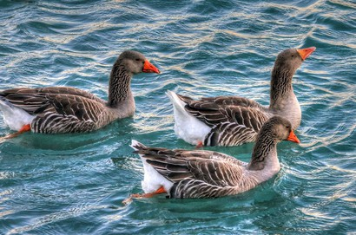
breakout questions
Ano yung isang “kahinaan” o "empty space" sa buhay mo ngayon (is it school, bad habits, or
finances) na nahihirapan kang isuko kay Lord?
Sa gitna ng iyong pinagdadaanan ngayon, paano mo mas maipapahayag ang iyong standing kay Kristo sa halip na mag-focus sa iyong pabago- bagong sitwasyon?
Kapag nakaramdam ka ng kabiguan o kapag nagkamali ka, ano ang pwede mong sabihin sa sarili mo para ipaalala na "righteous" ka pa rin kay Kristo (your permanent standing)?

