Slide 1







HOUSE OF GRACE FELLOWSHIP
Grounded in the Word · Renewed in Christ
Saved by Grace, Made New
EPHESIANS 2:8-9
2 CORINTHIANS 5:17
For by grace you have been saved through faith; and this is not of yourselves, it is the gift of God; not a result of works, so that no one may boast.
“Therefore if any man be in Christ, he is a new creature: old things are passed away; behold, all things are become new.”

Slide 2


Built for
Transformation
Grace Changes What Fear Can’t
2 Kings 6:15–23

Slide 3

1. Grace Changes the Way We Think
(2 Kings 6:15–16)

Slide 4



2 Kings 6:15
And his servant said to him, “This is hopeless, my master! What are we to do? What are we going to do?”

Slide 5
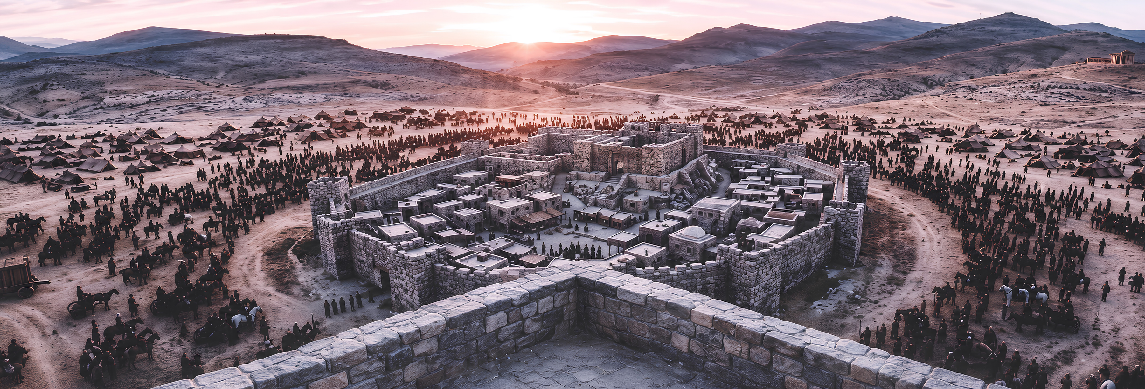

Slide 6



Pressure doesn’t create what’s inside us; pressure reveals what’s already there.
Pressure
Pressure
Pressure
Pressure

Slide 7


Elisha’s Response
(v. 16)
“Do not be afraid, for those who are with us are greater than those who are with them.”

Slide 8

1 John 4:4
Isaiah 41:10
You are from God, little children, and have overcome them; because greater is He who is in you than he who is in the world.
Do not fear, for I am with you...
I will strengthen you, surely, I will help you...

Slide 9


2. Grace Changes the Way We See
(2 Kings 6:17)

Slide 10
2 Kings 6:17
Then Elisha prayed and said, “Lord, please, open his eyes so that he may see.” And the Lord opened the servant’s eyes, and he saw; and behold, the mountain was full of horses and chariots of fire all around Elisha.

Slide 11




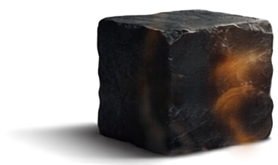
Elisha’s Prayer: “Lord, please, open his eyes so that he may see.”
Changing the situation
Changing the sight

Slide 12
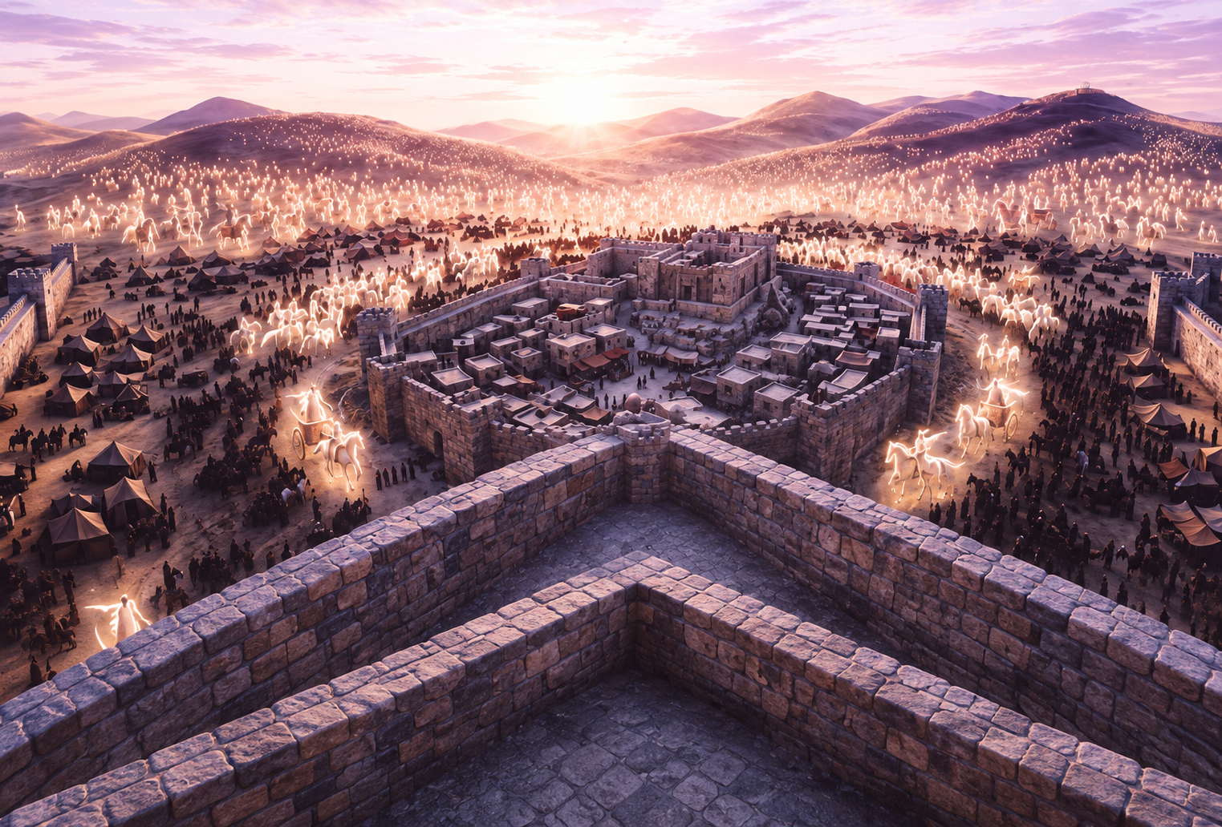

Slide 13

When God changes the way we think, He also begins to change the way we see our situation.

Slide 14
Grace doesn’t always change your situation first; sometimes it changes the way you see it.

Slide 15


3. Grace Changes the Way We Respond
(2 Kings 6:18–23)

Slide 16






The Unseen Path (2 Kings 6:18-20)
He struck them with blindness in accordance with the word of Elisha.
Follow me and I will bring you to the man whom you seek.
Lord, open the eyes of these men, so that they may see.

Slide 17






Elisha (v. 22)
The King of Israel (v. 21)
“You shall not kill them... Set bread and water before them, so that they may eat and drink, and go to their master.”
“My father, shall I kill them? Shall I kill them?”
Revenge.
Serving them lunch.

Slide 18


That’s why we forgive. That’s why we love our enemies, not because they deserve it, but because we didn’t deserve God’s grace either.

Slide 19





Maybe today you feel surrounded.
Debt
Stress
YOU
Uncertainty
Sickness

Slide 20





Debt
You may be surrounded, but you are never abandoned.
Stress
YOU
Uncertainty
Stickness

Slide 21









God didn’t just send angels to help us; He sent His Son. Jesus came not only to forgive our sins, but to transform our hearts.
Fear and Rules
Changes behavior for a season.
Jesus and Grace
Changes a person from the inside out.

