Slide 1
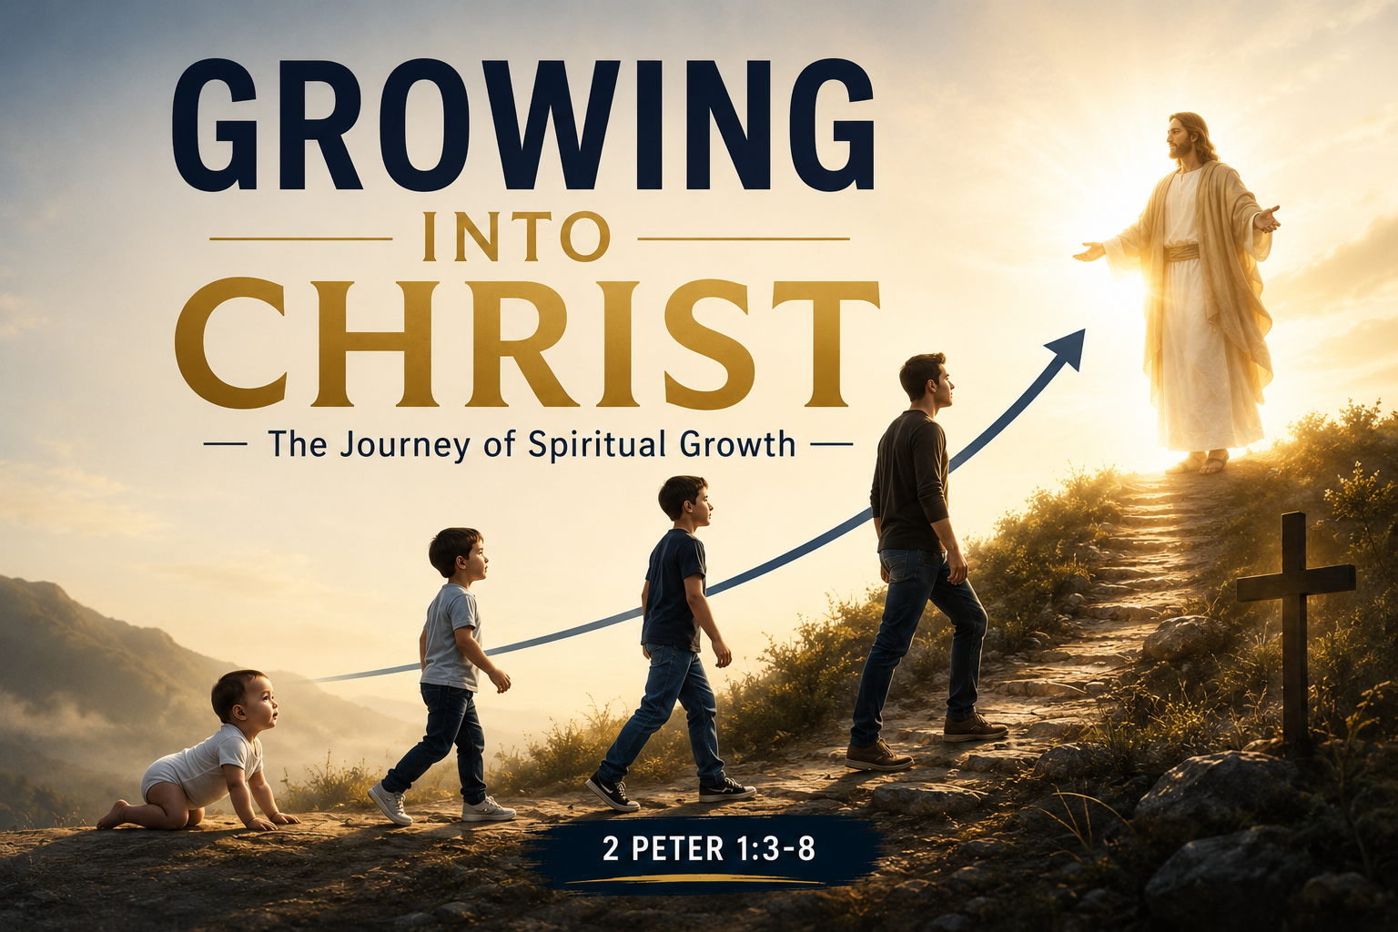
GROWING INTO CHRIST
The journey of spiritual growth
GRACE NIGHT
GRACE NIGHT

Slide 2
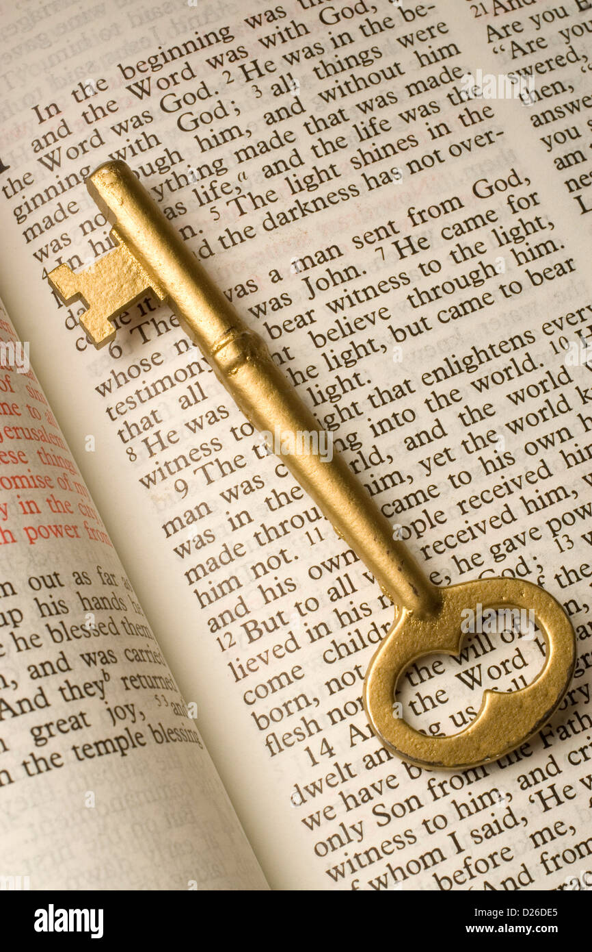
Key Scriptures
1 PETER 1:3-8

Slide 3
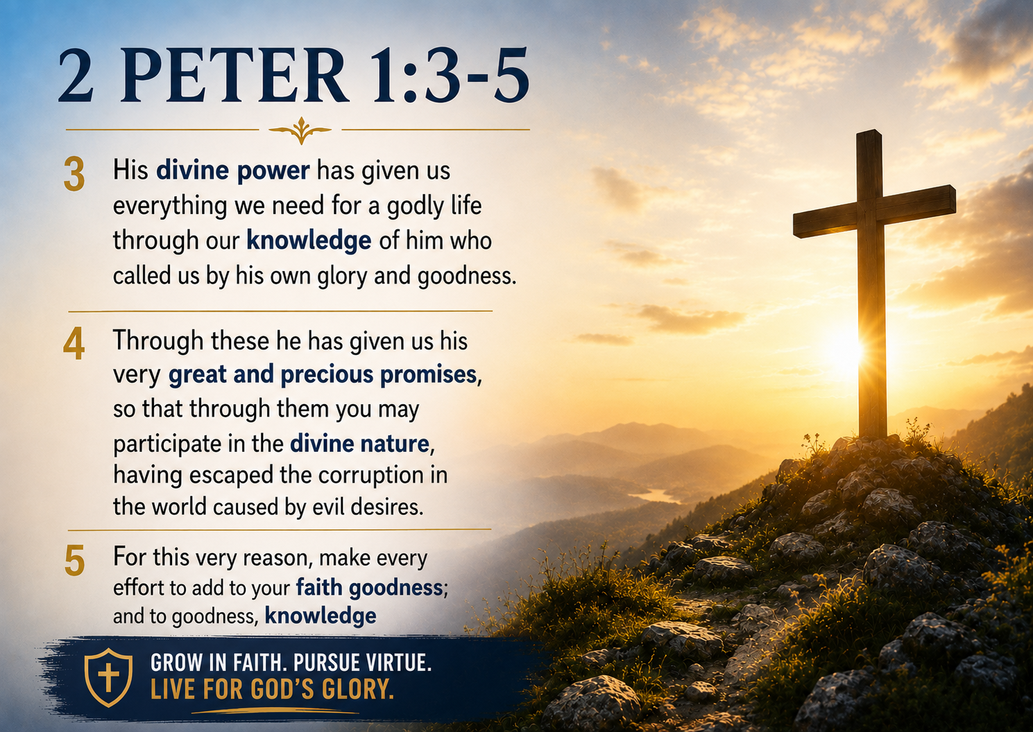

Slide 4


Slide 5
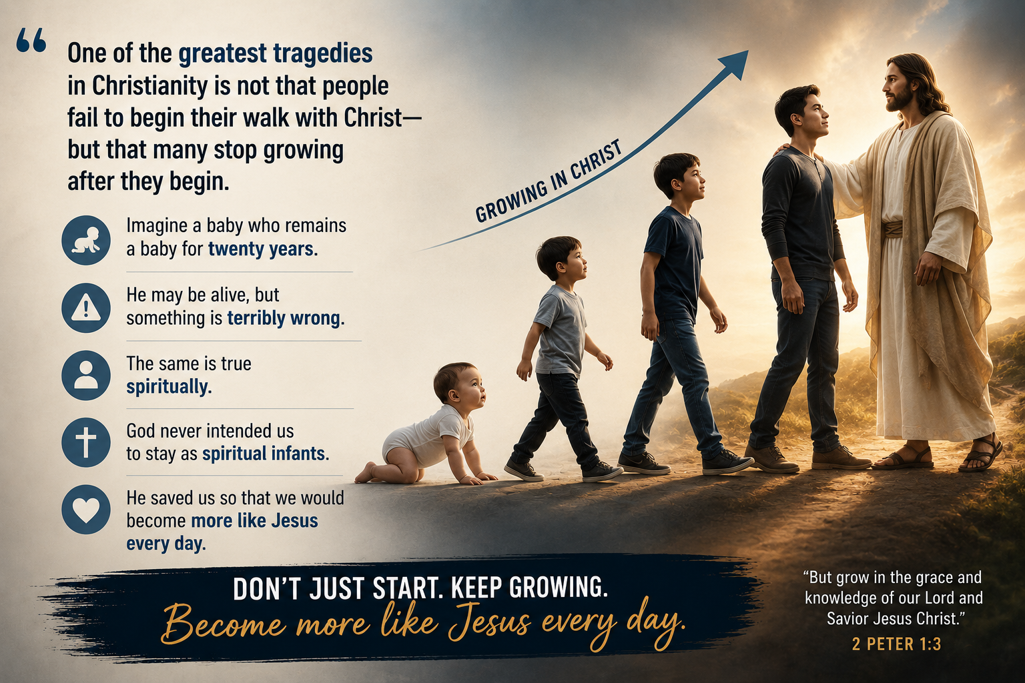

Slide 6


Slide 7


Slide 8


Slide 9


Slide 11
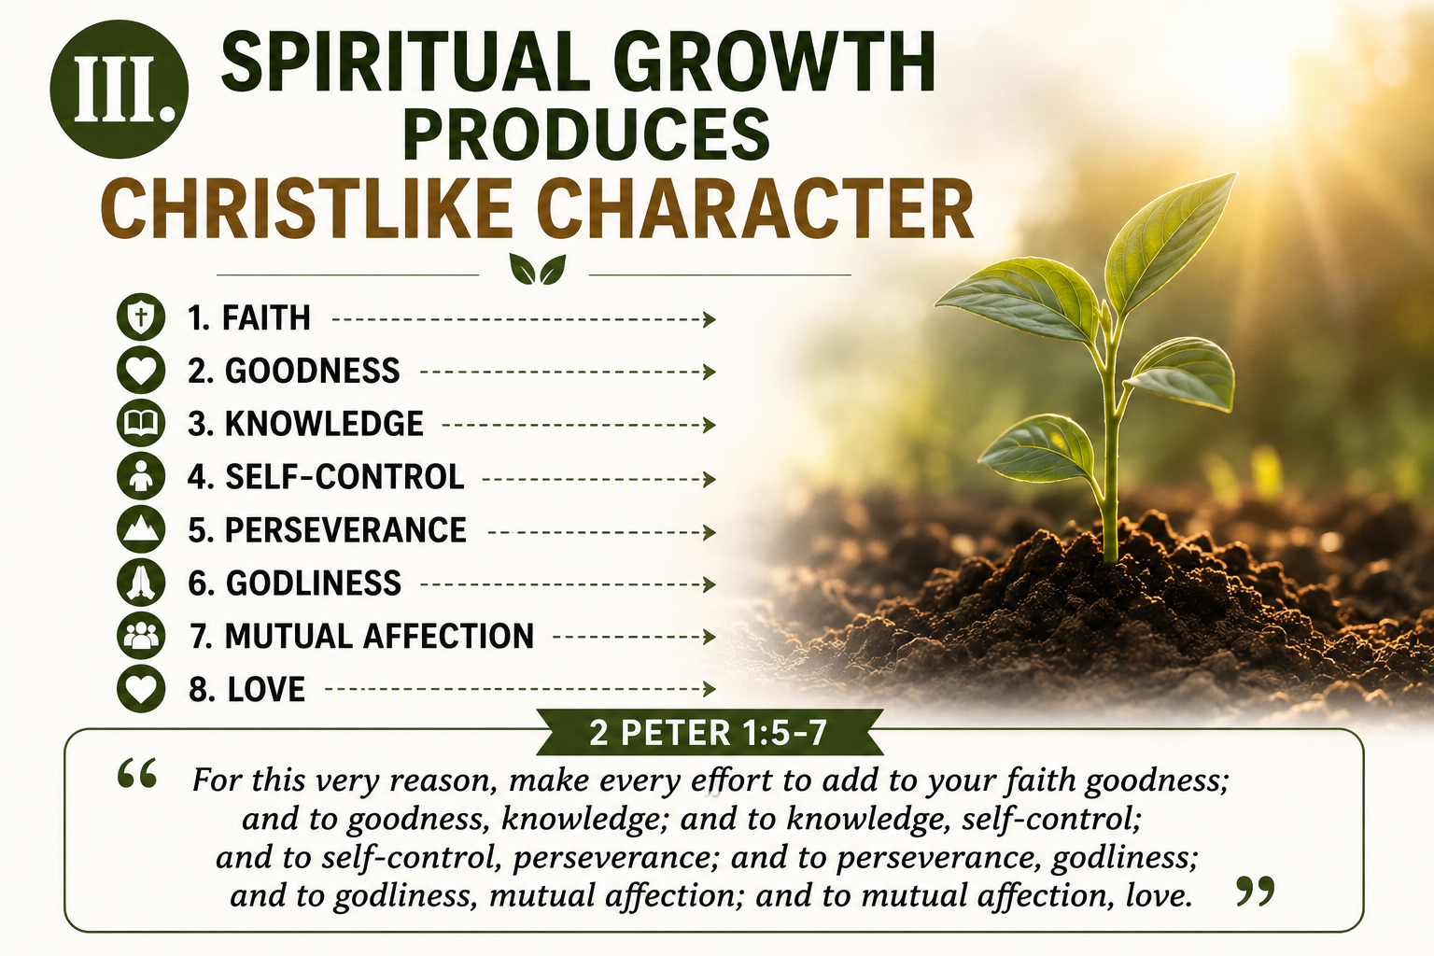
God guides us one step at a time.

Slide 12


Slide 13


Slide 14


Slide 15


Slide 16


Slide 17
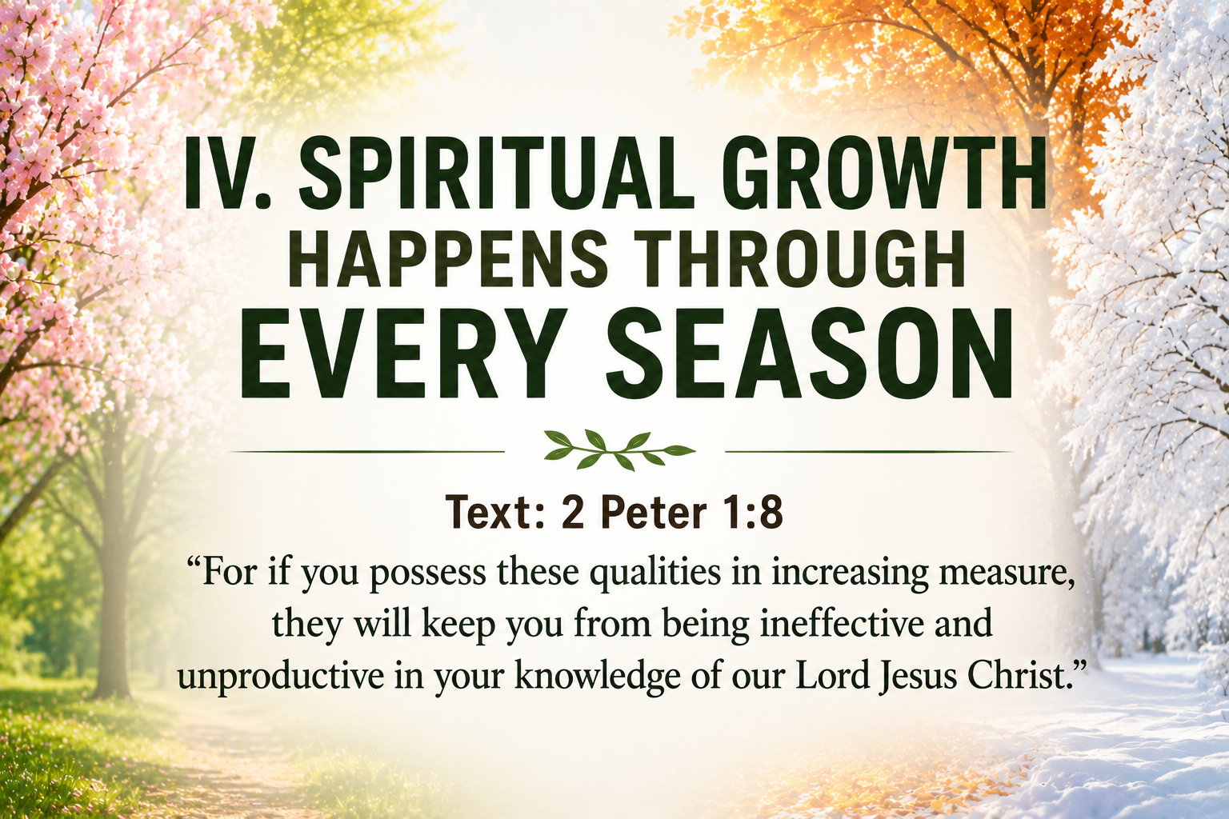

Slide 18


Slide 19
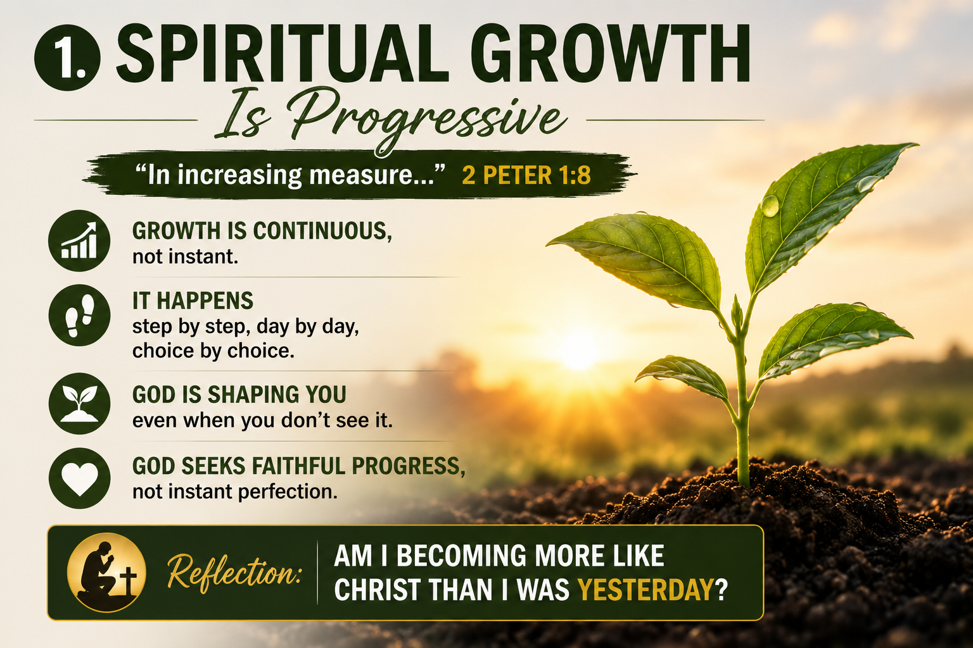

Slide 20
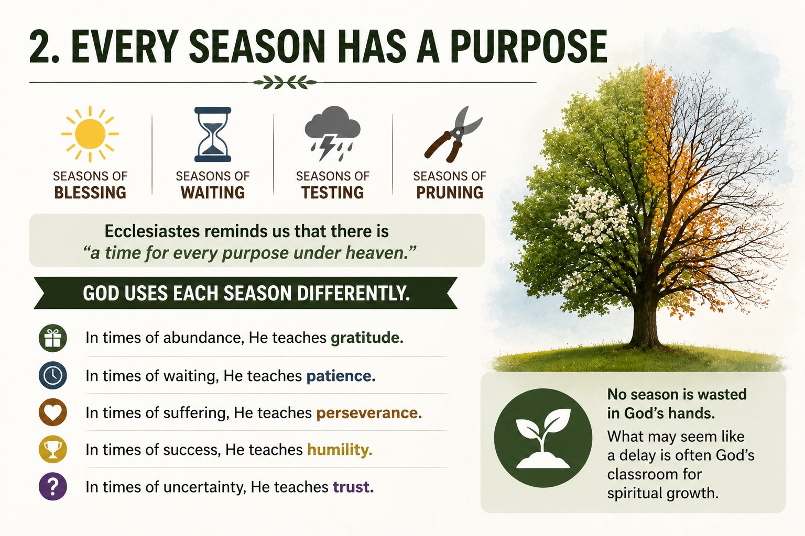

Slide 21
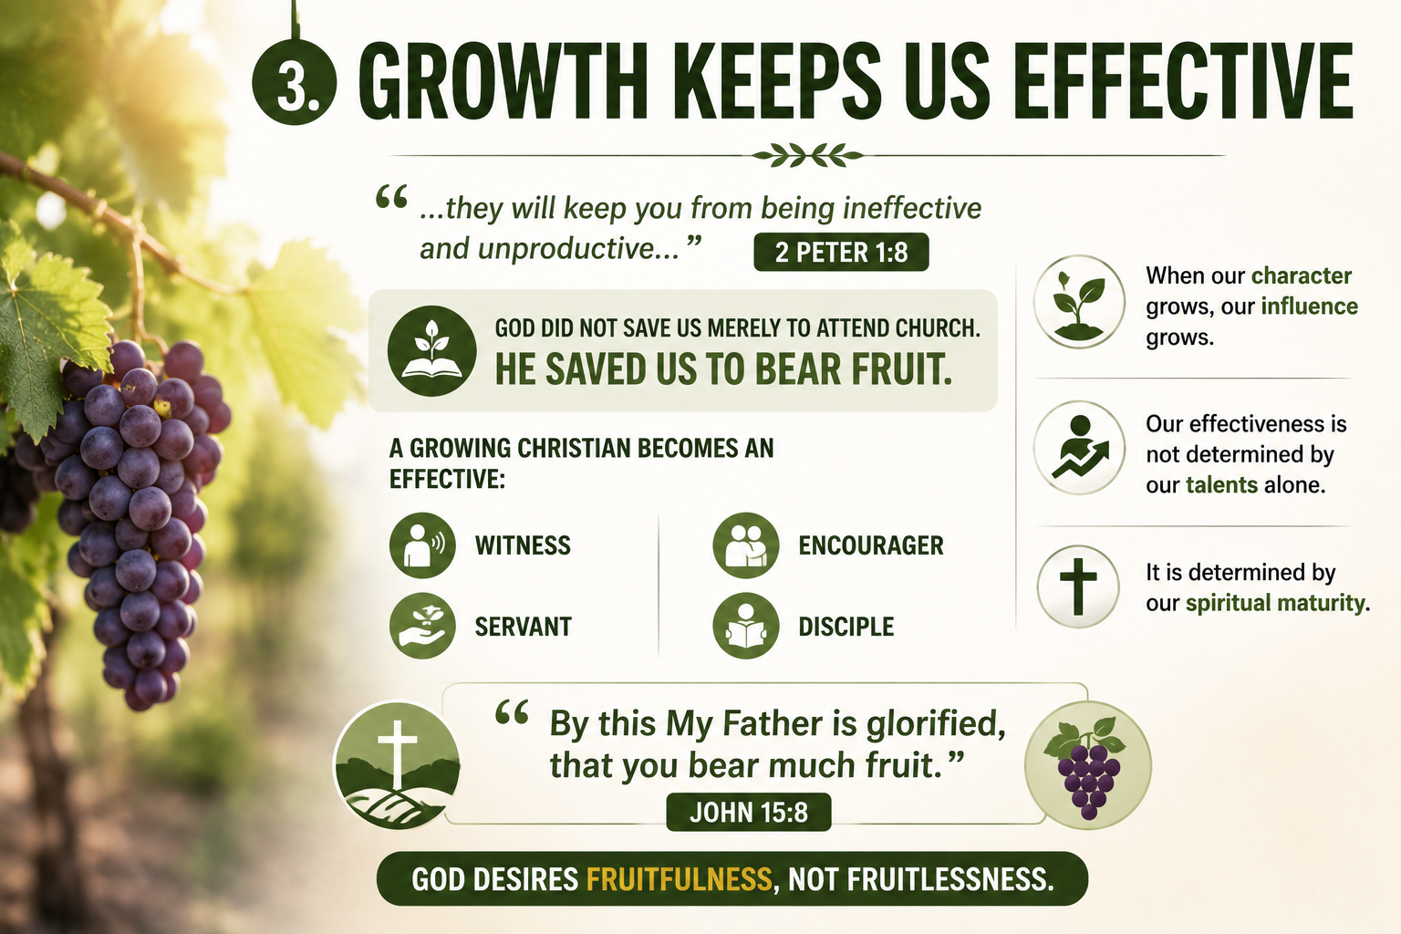

Slide 22
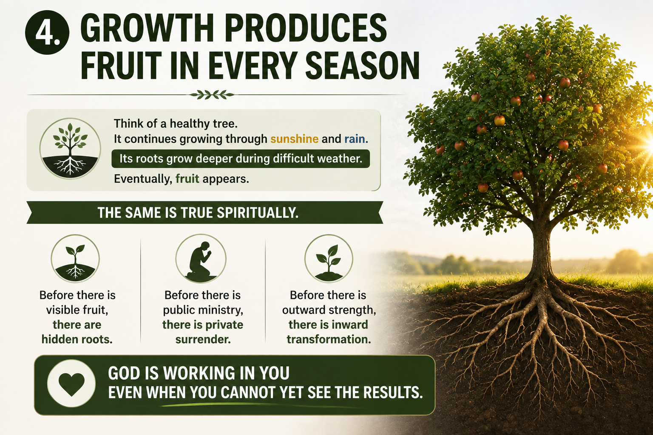

Slide 23


Slide 24
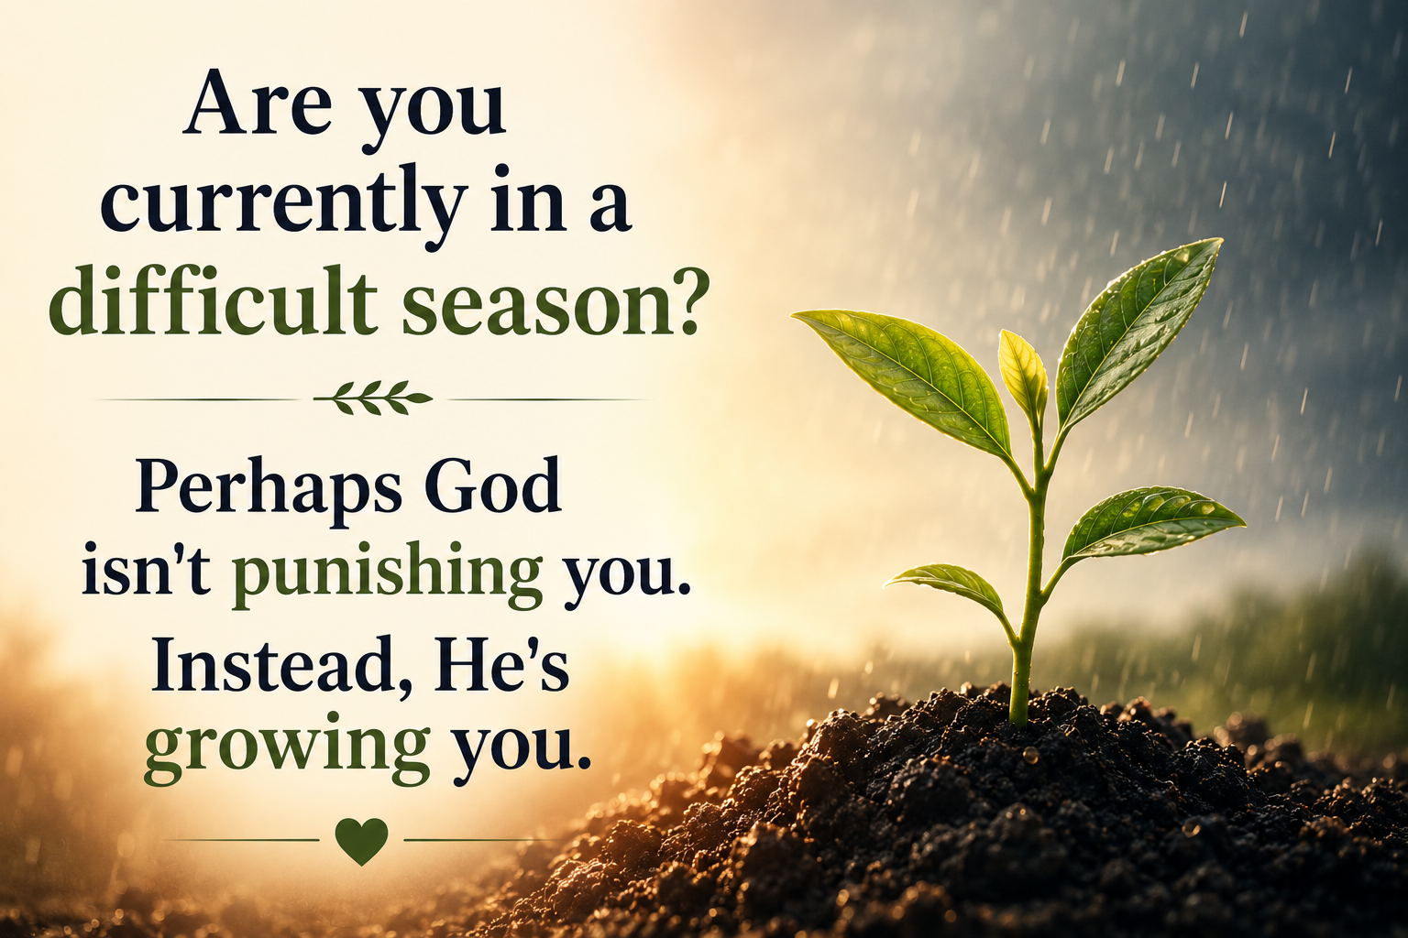

Slide 25
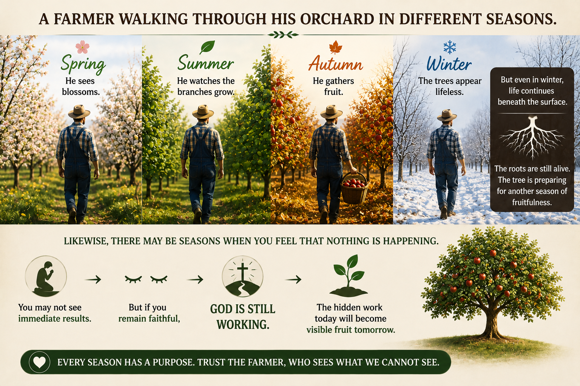

Slide 26
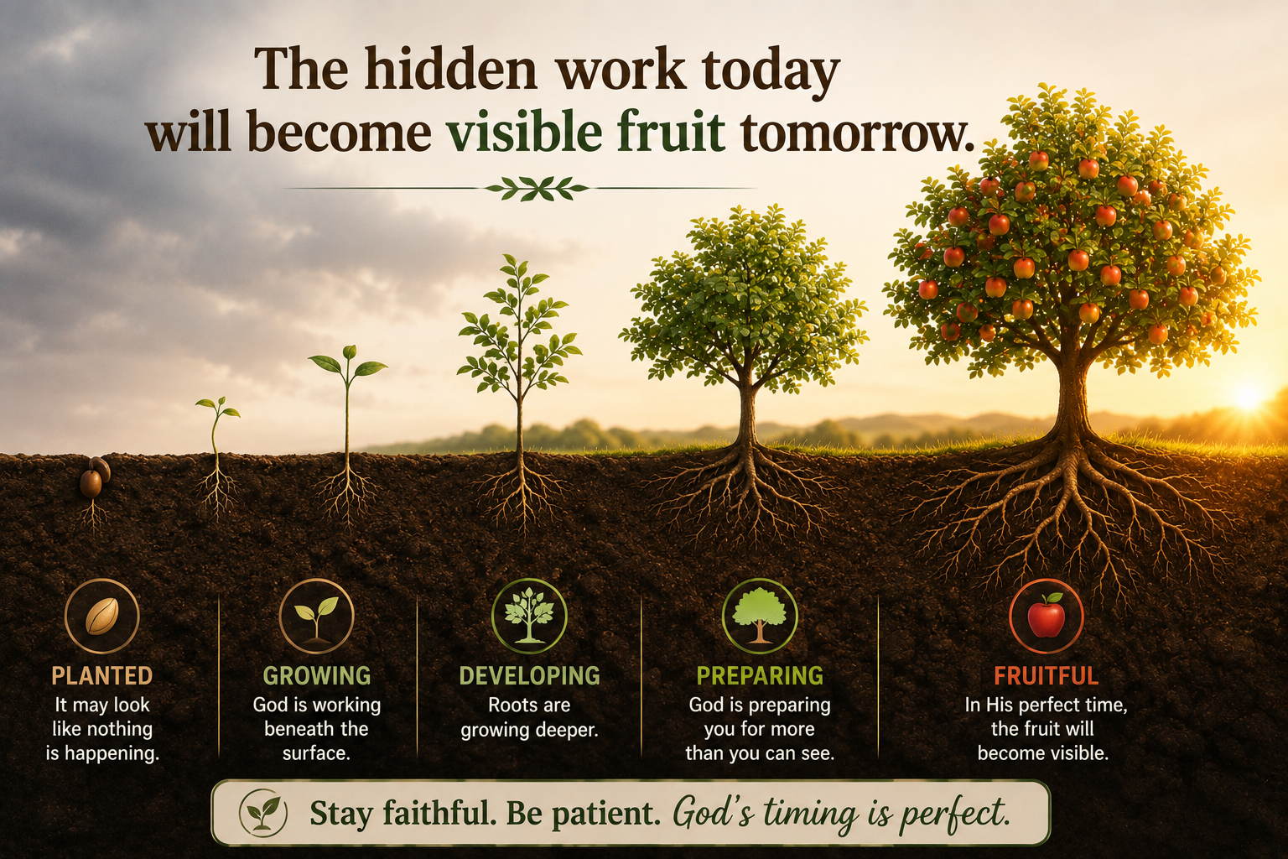

Slide 27


Slide 28
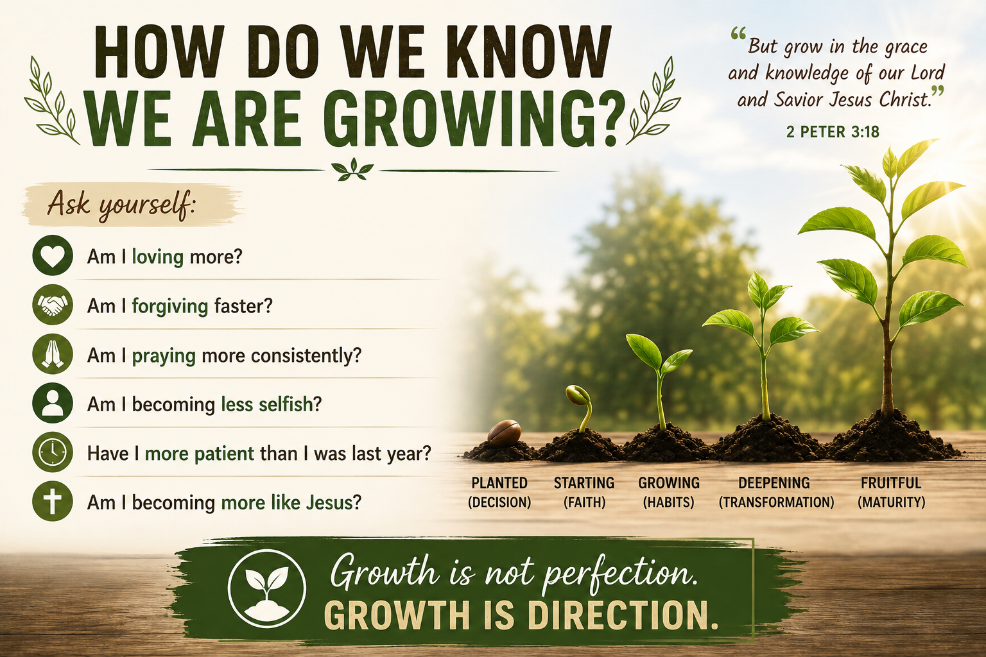

Slide 29


Slide 30


Slide 31
