Slide 1


Slide 2


Slide 3


Slide 4


Slide 5


Slide 6
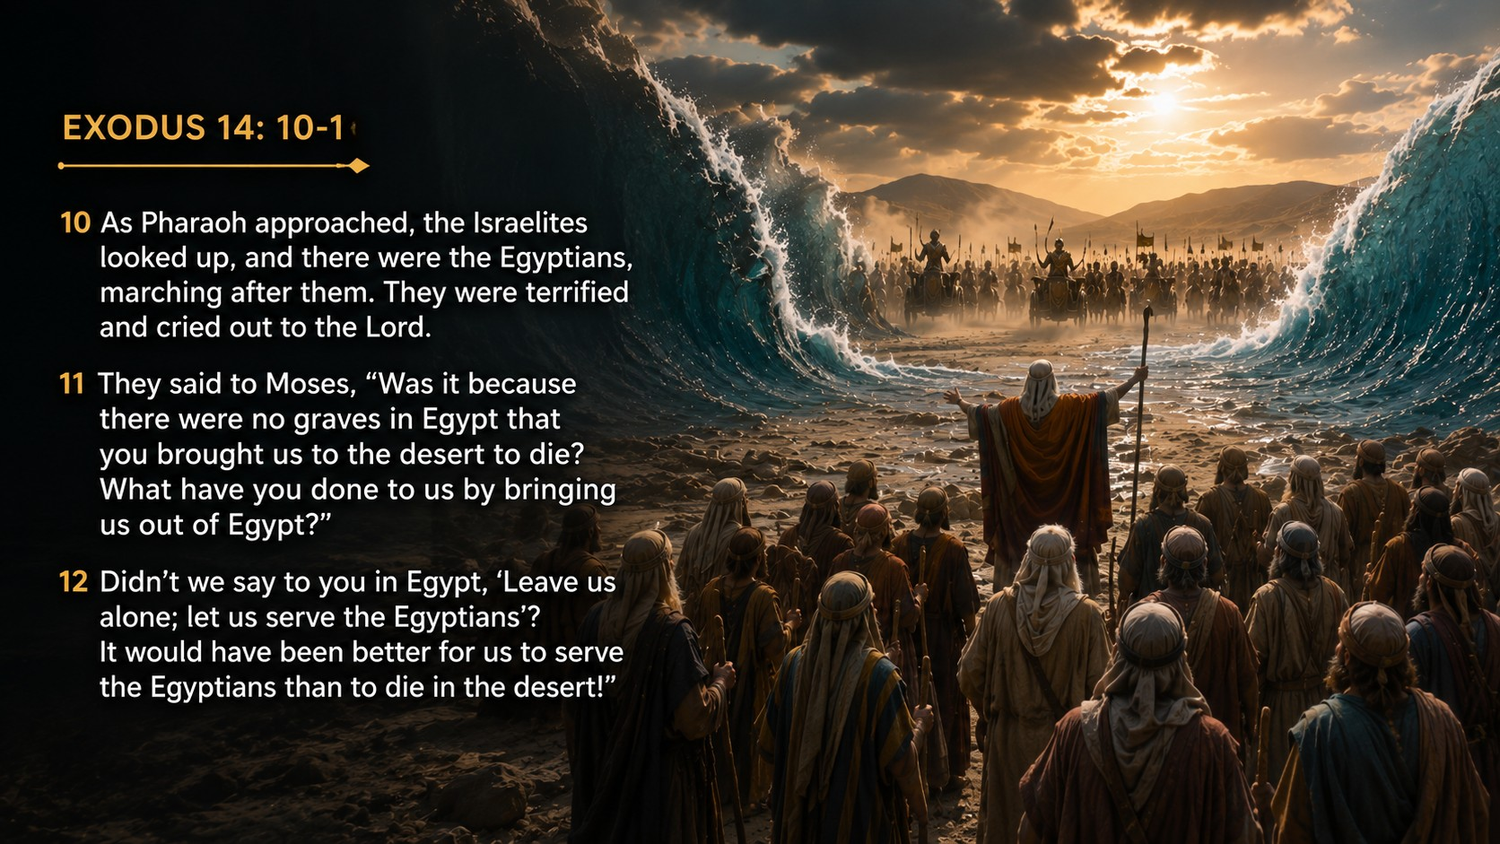
2

Slide 7
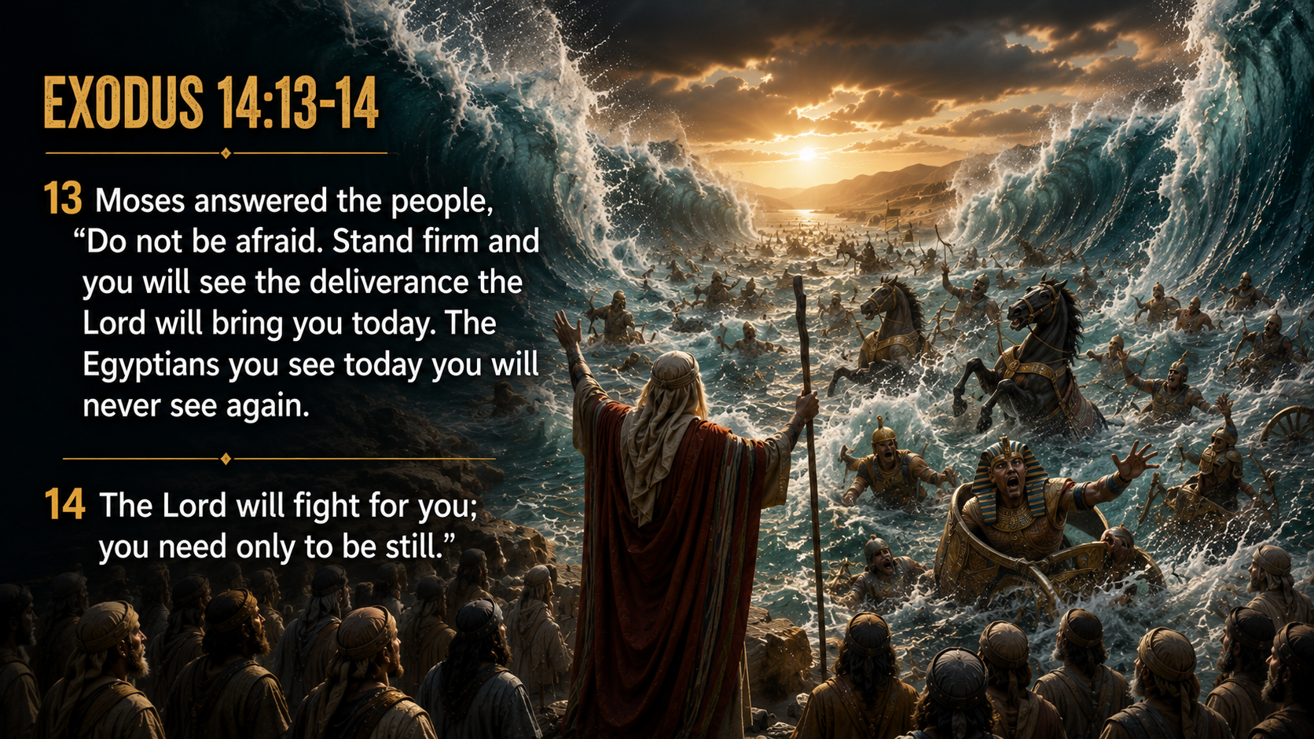

Slide 8
PLAY VIDEO

Slide 9
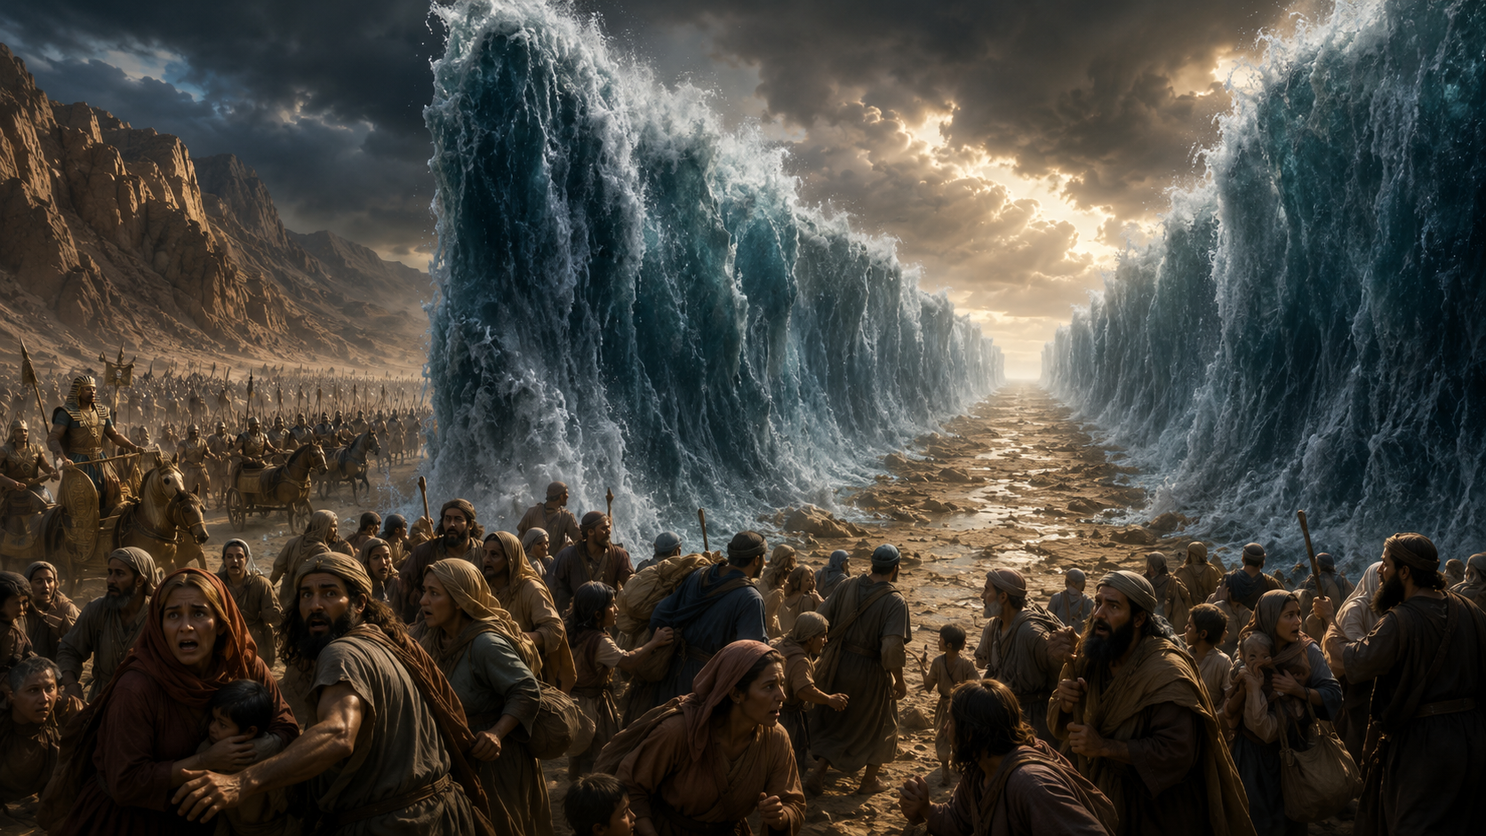

Slide 10


Slide 11
2

Slide 12
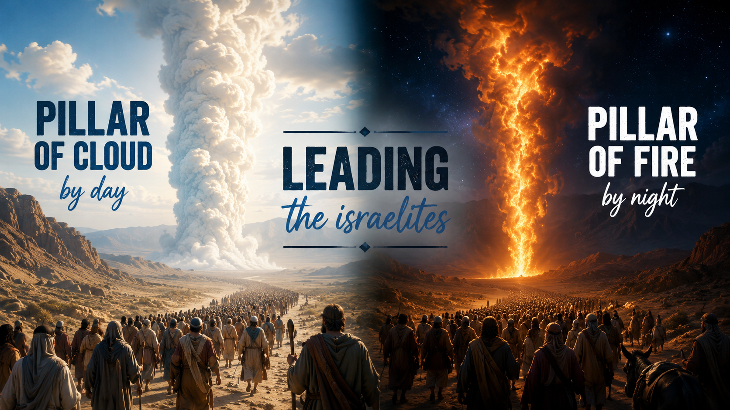
Exodus 13:21–22
"By day the LORD went ahead of them in a pillar of cloud to guide them on their way and by night in a pillar of fire to give them light..."

Slide 13
2

Slide 14


Slide 15


Slide 16
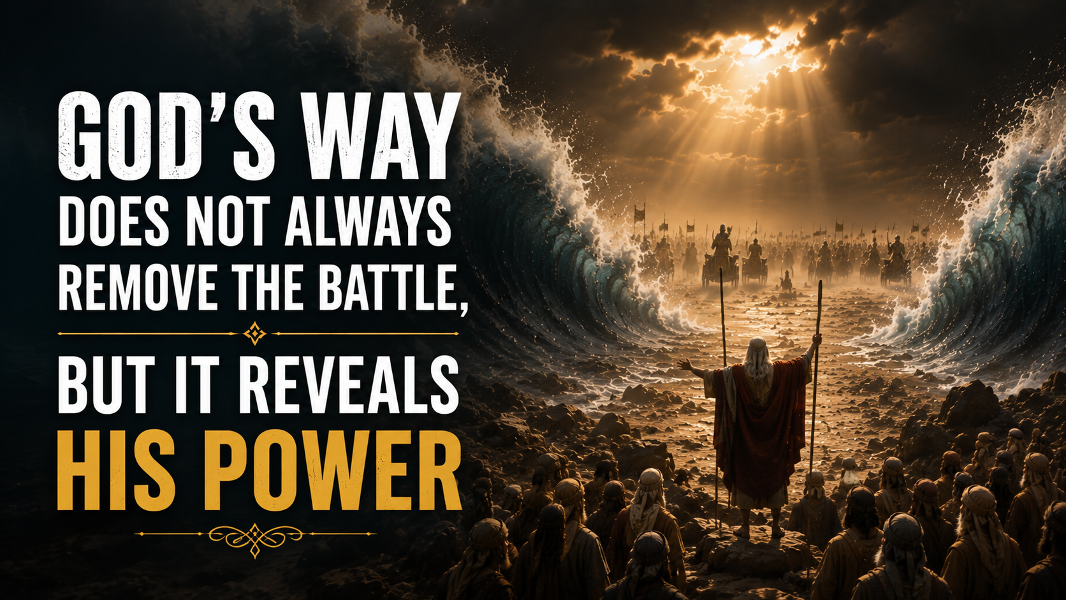

Slide 17
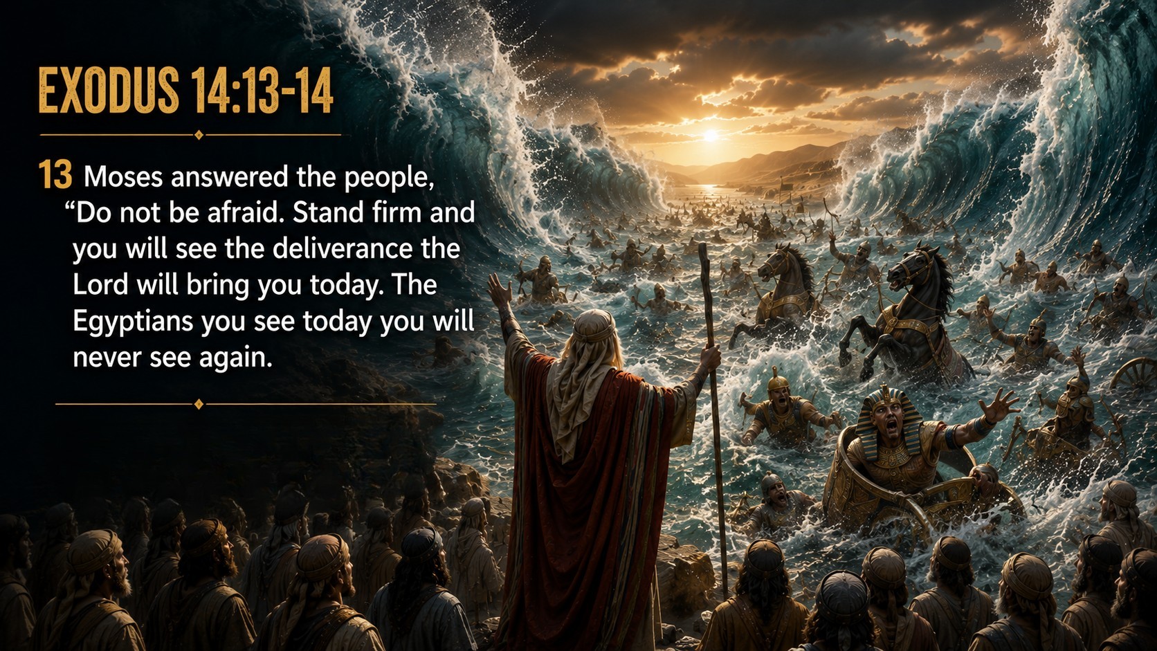

Slide 18
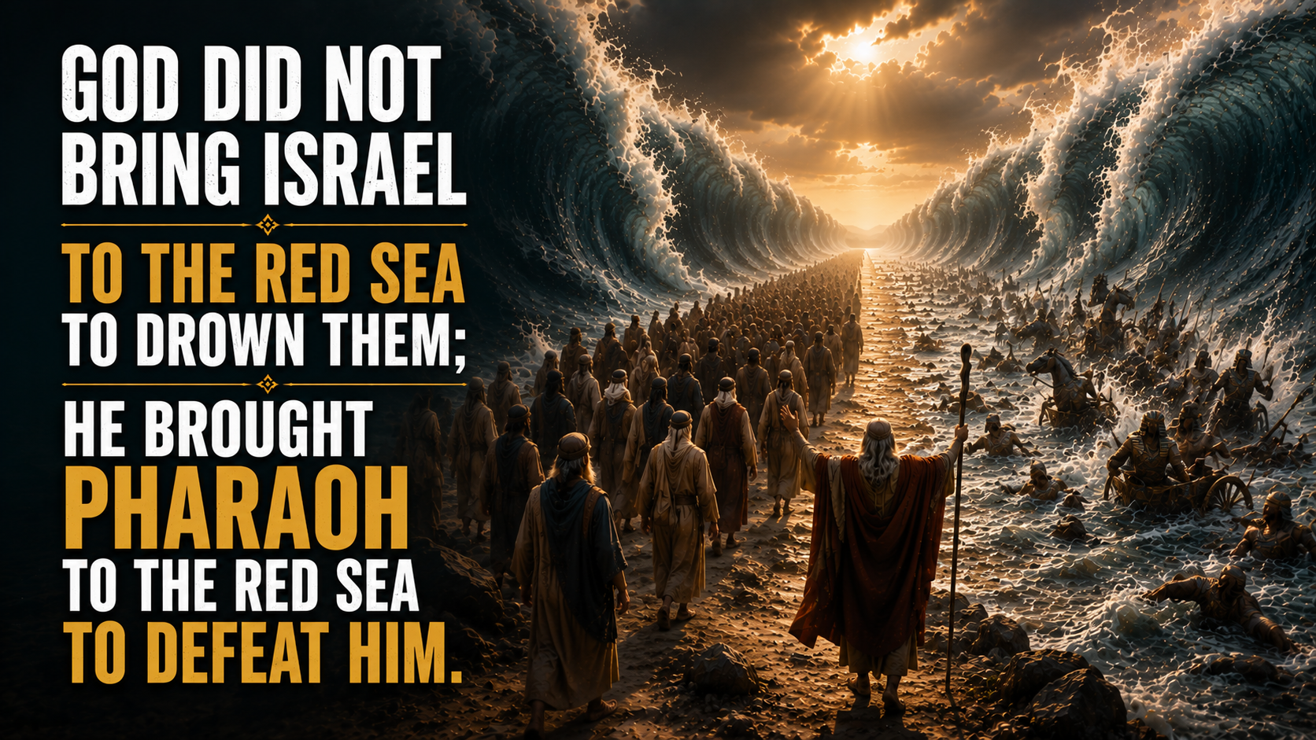

Slide 19
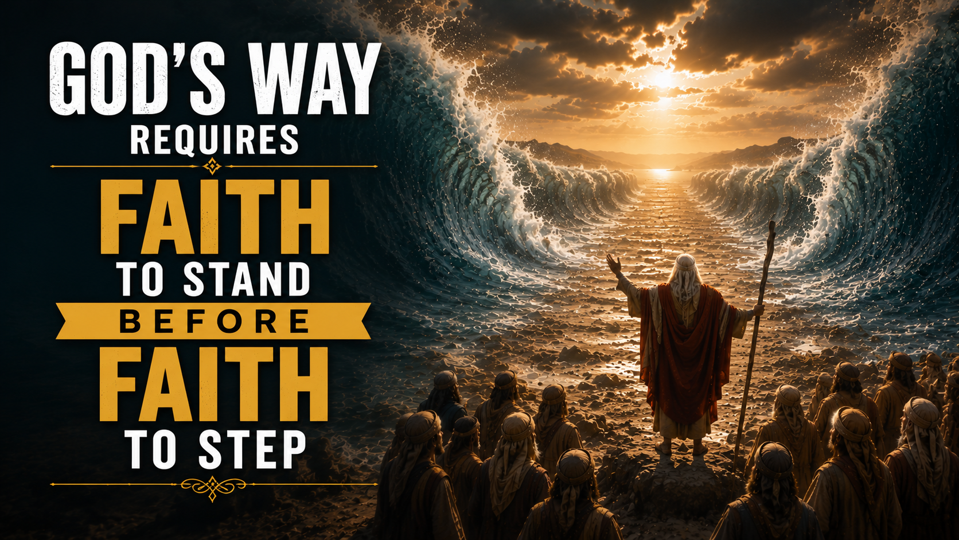

Slide 20


Slide 21


Slide 22


Slide 24


Slide 25


Slide 26
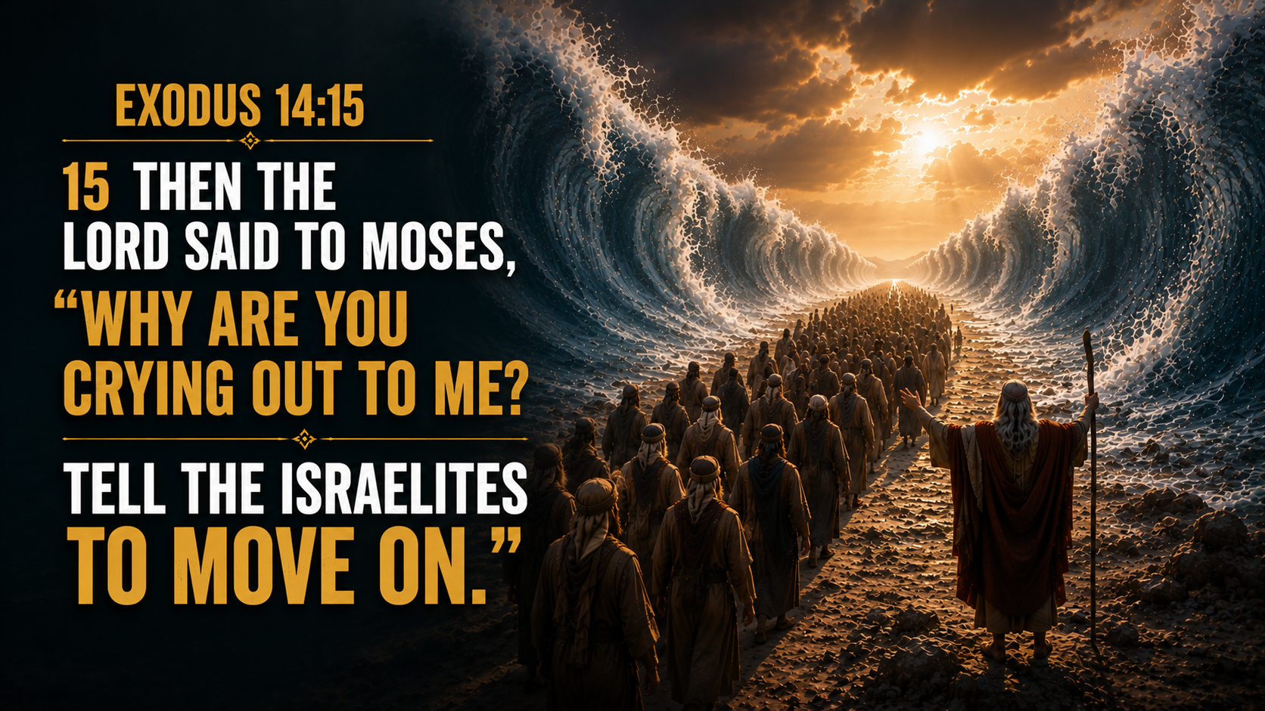

Slide 27
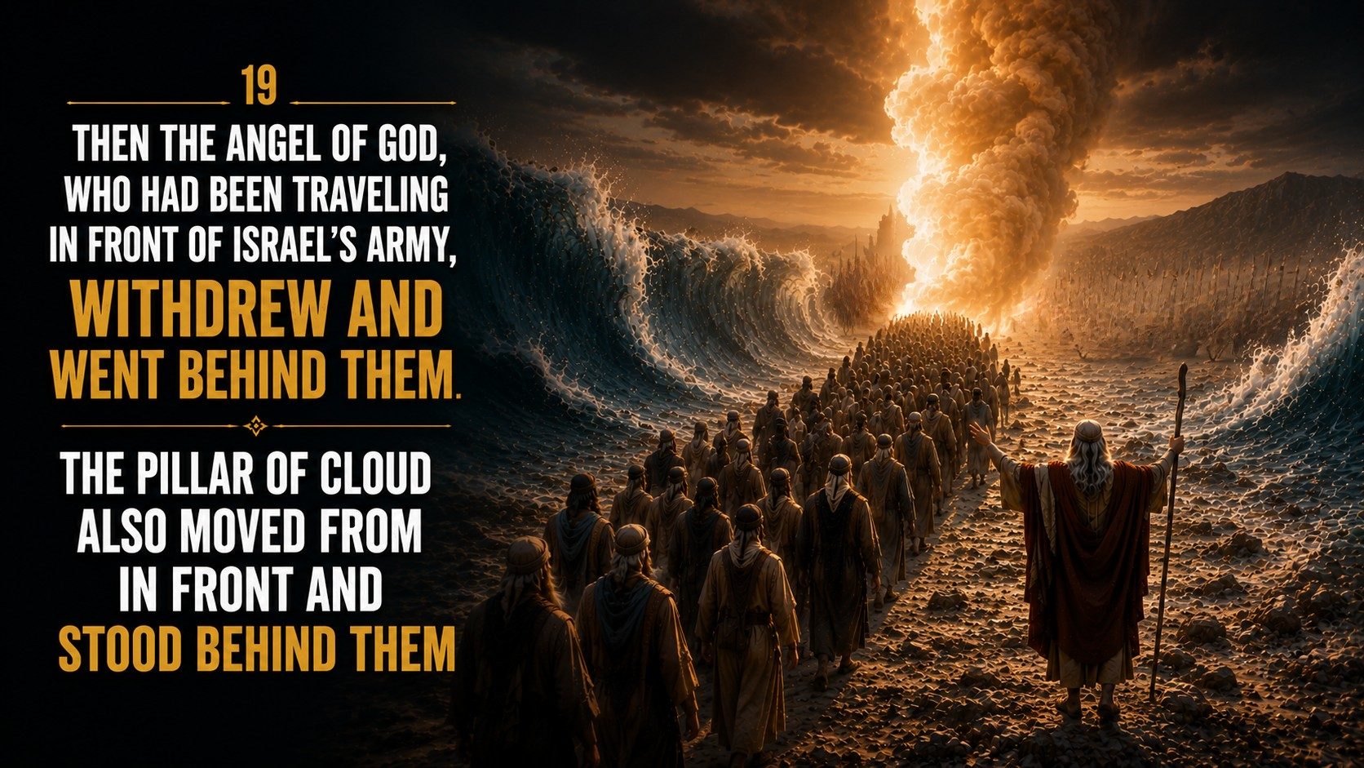

Slide 28
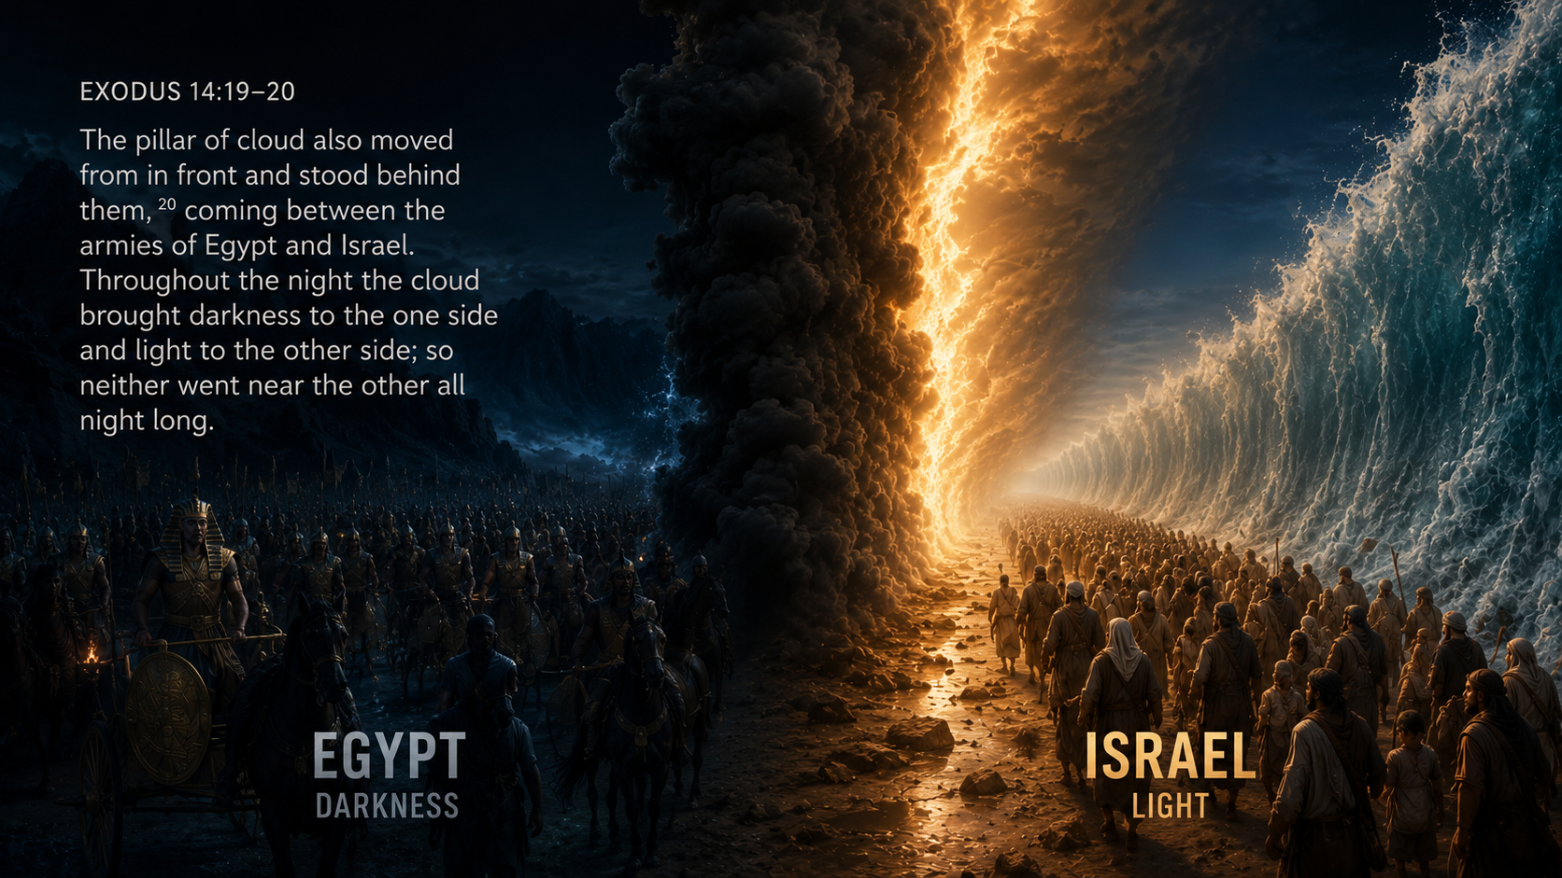

Slide 29
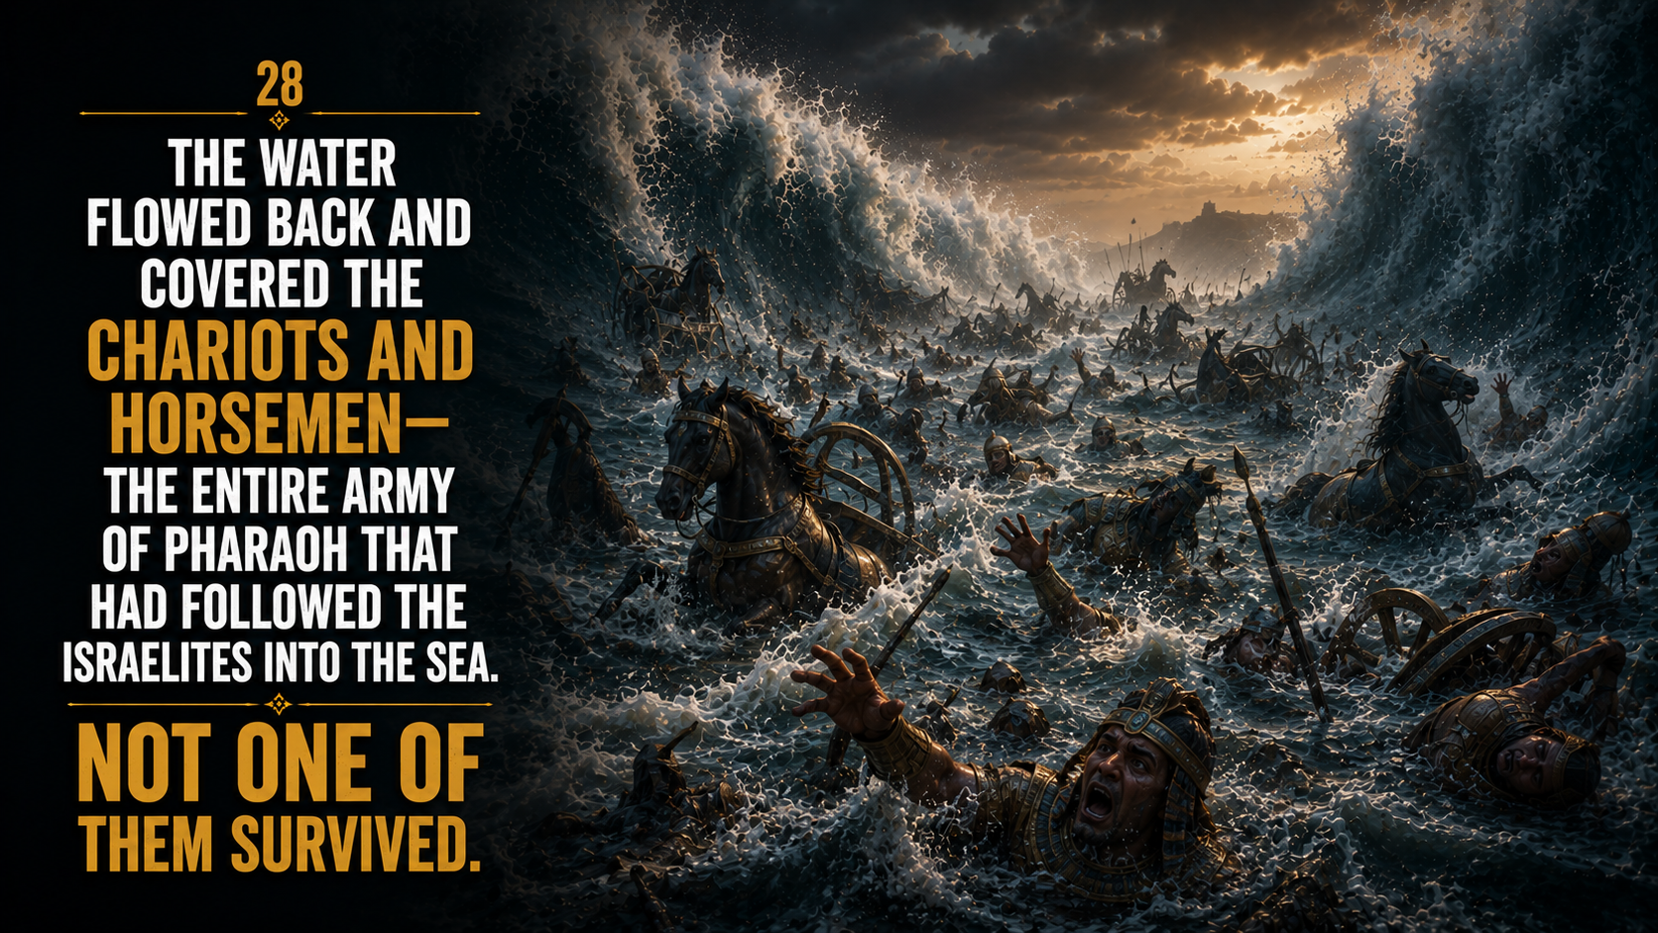

Slide 30
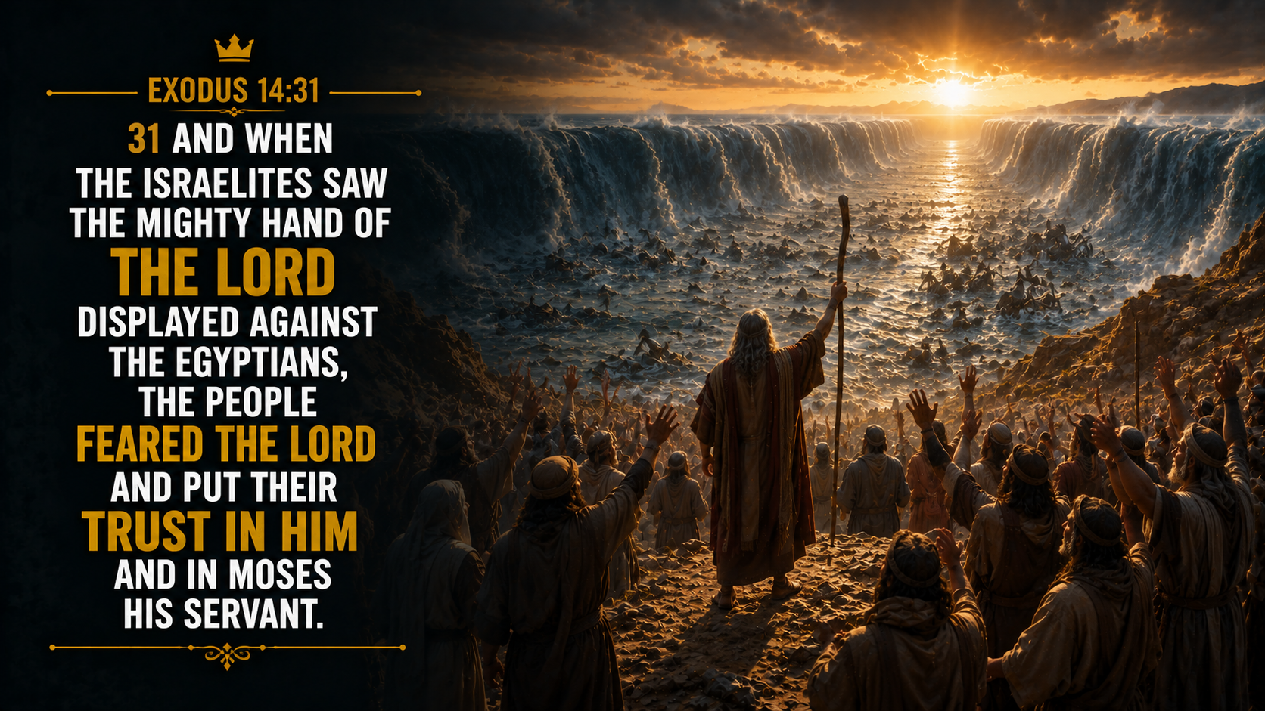

Slide 31
